Slide 2
RECOVERY: Recovery of degraded & transformed ecosystems in coal mining-affected areas (www.recoveryproject.eu)
1. Central Mining Institute (GIG), Poland - Coordinator
2. Universidad de Oviedo (UNIOVI), Spain
3. Humboldt Universität zu Berlin (UBER), Germany
4. Vysoka Skola Banska-Technicka Univerzita Ostrava (VSB), Czech Republic
5. Hulleras Del Norte SA (HUNOSA), Spain
6. Tauron Wydobycie SA (TWD), Poland
7. DIAMO, státní podnik, odštěpný závod PKÚ (PKÚ), Czech Republic

Slide 3
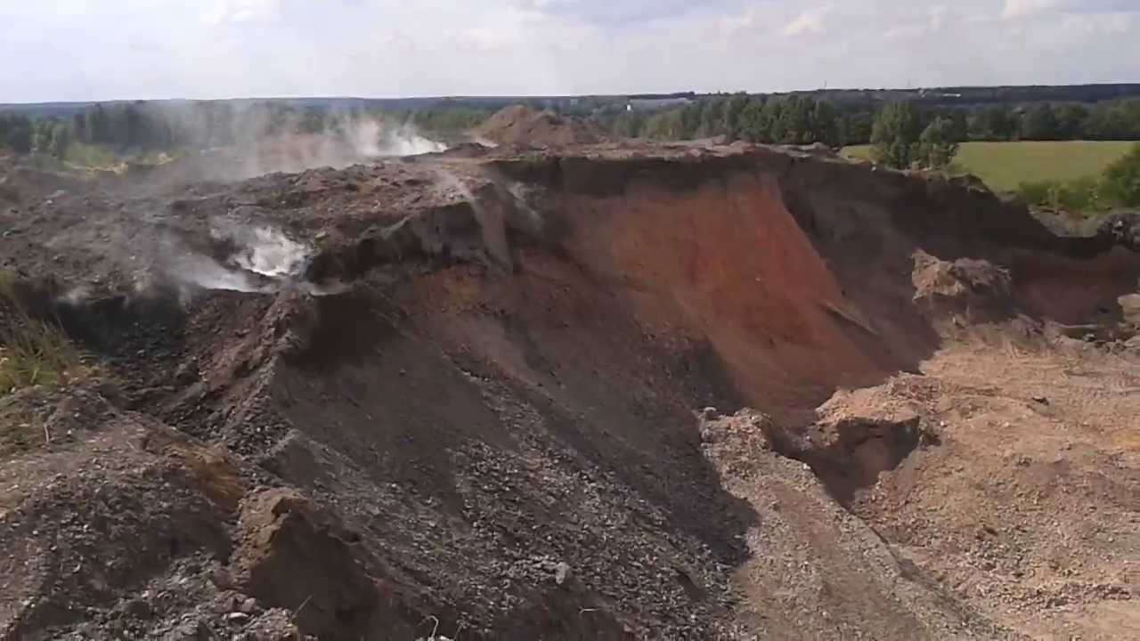
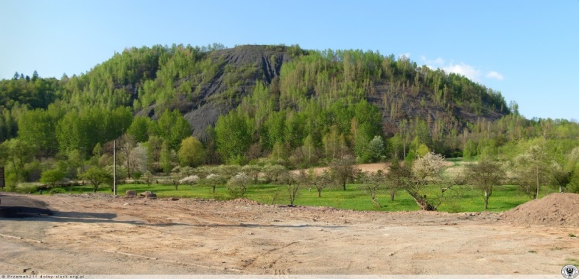
AIM OF THE RECOVERY PROJECT
RECOVERY project focuses on land rehabilitation and ecological restoration of coal mining-affected areas, aiming to accelerate the recovery of degraded and transformed ecosystems to a good ecosystem status.
Ecosystems impacted by mining are challenging to restore, further diminishing their capacity to generate benefits for society. Therefore, they provide an excellent framework for multidimensional analysing of the links between people and the environment.
LAND REHABILITATION
mapping, quantifying and valuating the ecosystem services provision

Slide 4
PROJECT’S METHODOLOGY
RECOVERY project is premised on the notion that management decisions about the ecological restoration of coal mining-affected areas involve trade-offs among ecosystem services. A quantitative assessment of these trade-offs is the necessary ingredient for sound decision-making.
Coal mining-affected areas in different stages of restoration
Quantify and map ecosystem services provision
current state
Quantify and map ecosystem services provision
Land rehabilitation and ecological restoration alternatives
scenario A
scenario B
Quantify and map ecosystem services provision
Quantify
the economic value of ecosystem services
Quantify
costs of
actions
Land rehabilitation
and ecological restoration options which deliver the greatest benefits relative to their investment and maintenance cost

Slide 5
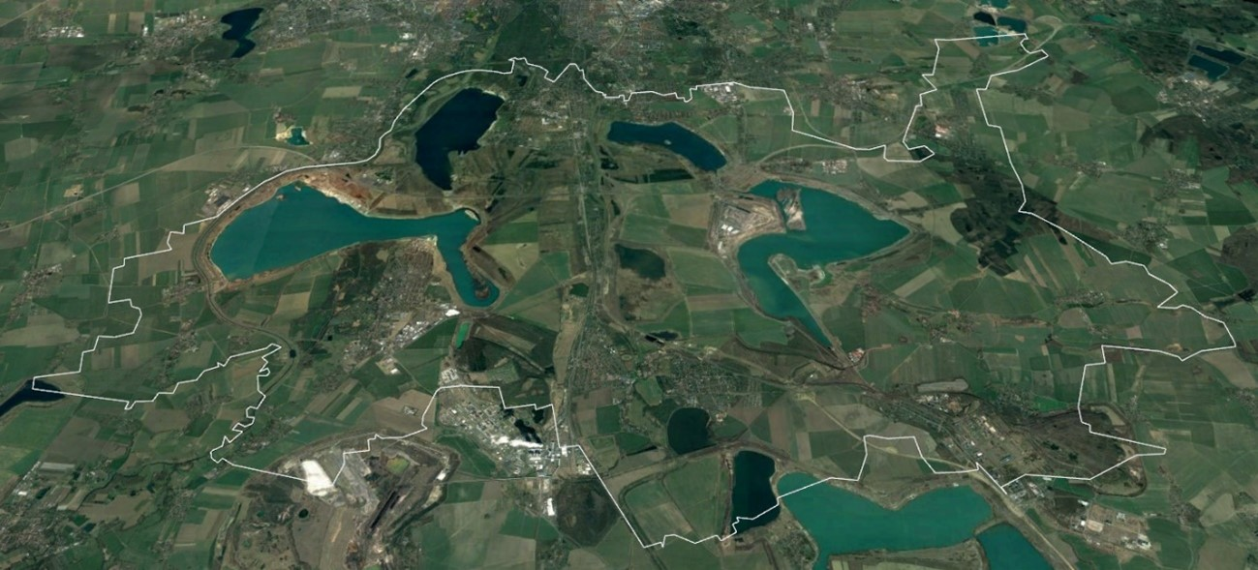
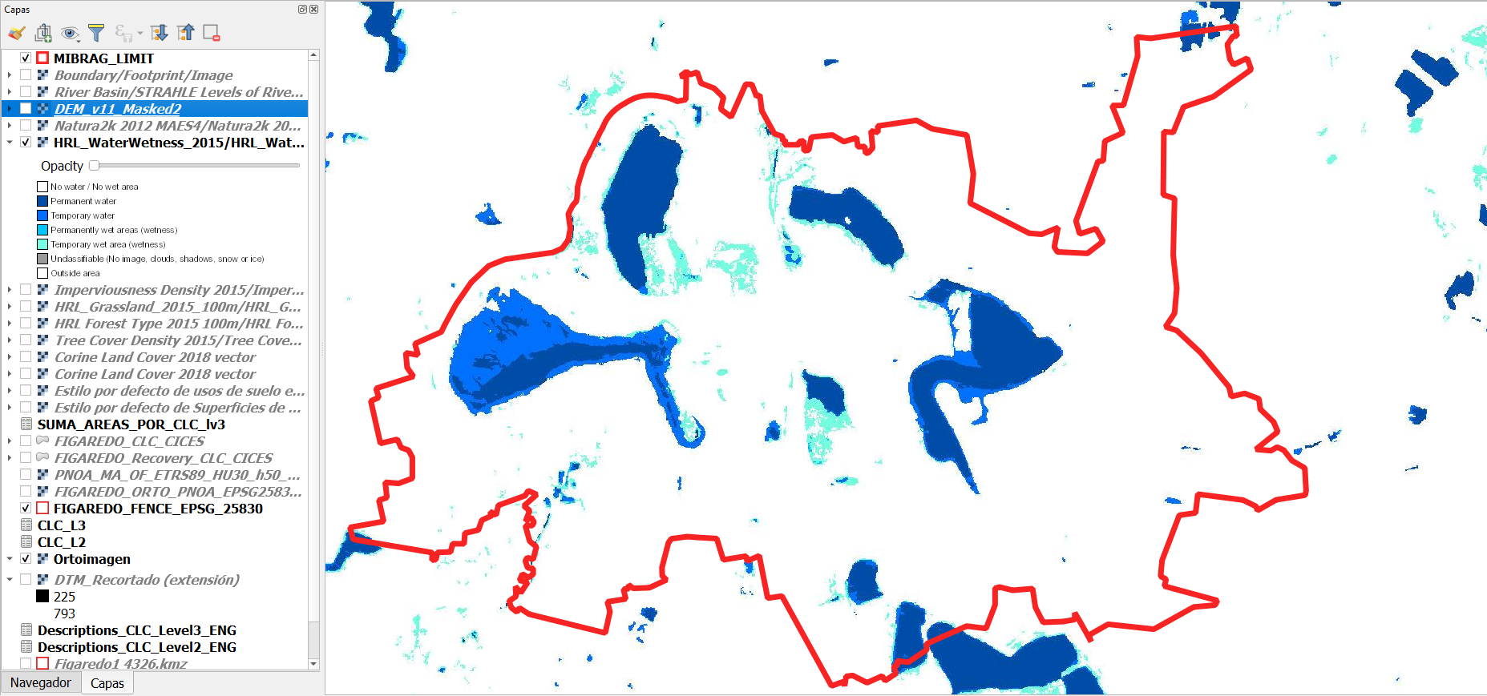
BASELINE MAPPING OF RELEVANT ECOSYSTEMS
First, adequate boundaries for the study areas were defined based on the existing spatial connectivity and functional cohesion.
Second, a revision of the available online geospatial data was developed, mainly from COPERNICUS, a Program whose main objective is to establish an Earth Observation System under the mandate of the European Commission.
COPERNICUS Water and Wetness 2015
Boundaries selected for
Mibrag Mines in Germany

Slide 6
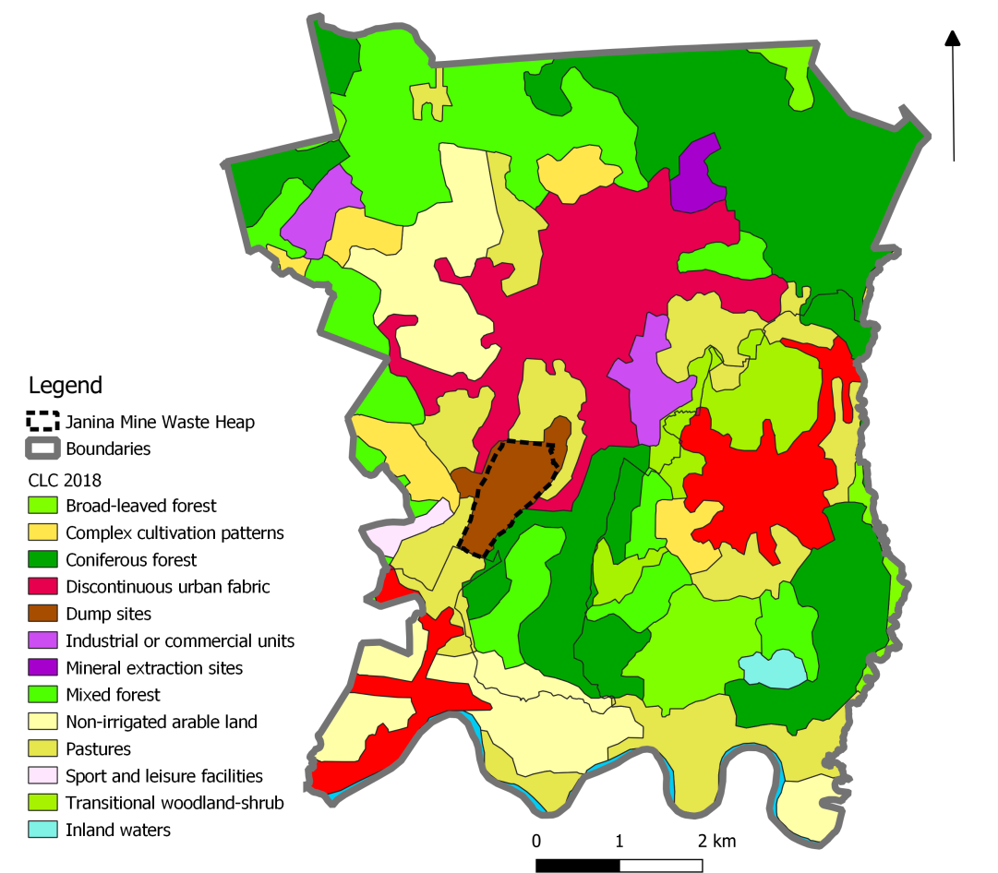
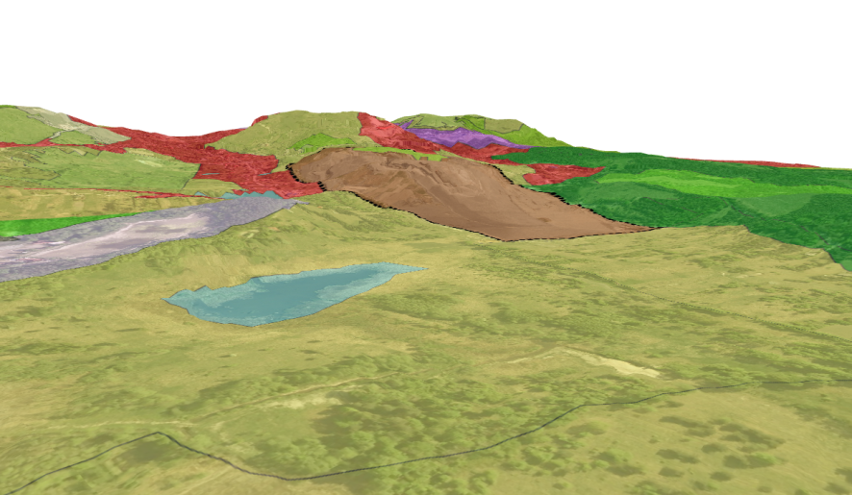
BASELINE MAPPING OF RELEVANT ECOSYSTEMS
Third, CORINE Land Cover classes were used to map the different ecosystem types of land cover in the study areas. However, doing detailed field mapping at a higher resolution.
3D image of the CLC classes
of Janina Mine in Poland
CLC classes in Janina
Mine (Poland)

Slide 7
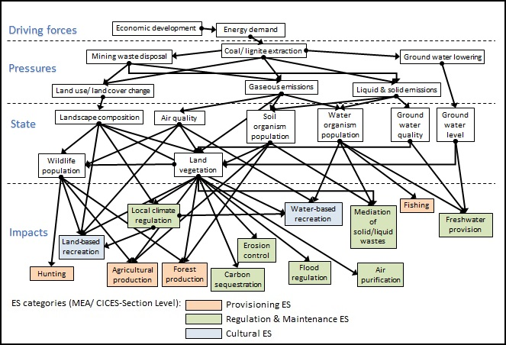
ASSESSMENT OF ECOSYSTEM SERVICES
The hierarchical structure of the Common International Classification of Ecosystem Services (CICES) V5.1 was used, as well as an established and widely known causal chain approach: the Driving Forces-Pressures-State-Impact-Response (DPSIR) framework, developed by the European Environmental Agency.
Causal network of
coal mining impacts

Slide 8
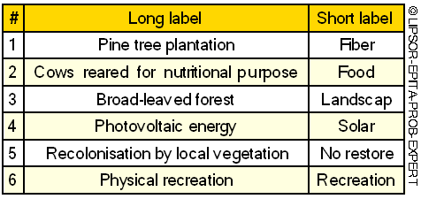
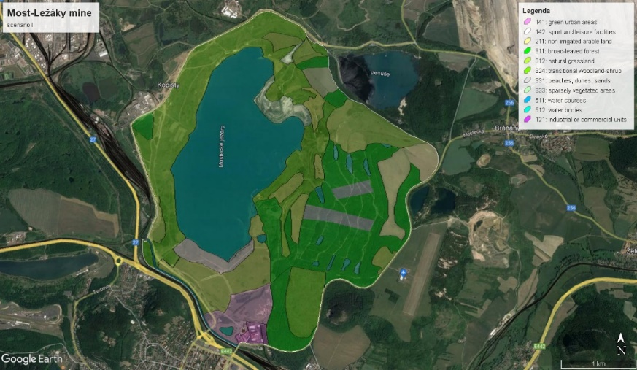
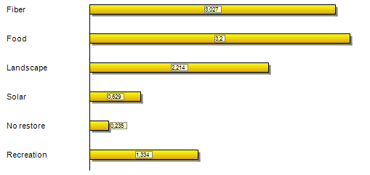
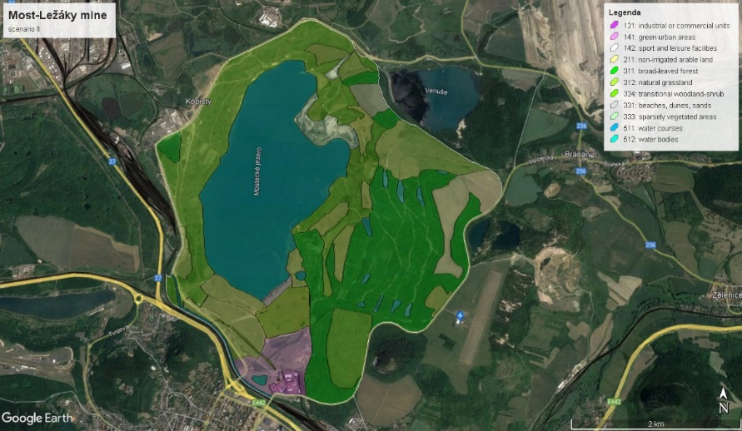
GENERATION OF SCENARIOS
To adequately select the strategies that should be considered, stakeholder consultations were used as a reference, together with the different types of land rehabilitation and ecosystem restoration alternative actions that could be proposed for the areas.
Scenario I in Most-Ležáky (Czech Republic):
RECREATION
Scenario III in Most-Ležáky (Czech Republic):
NATURE
The Smic Prob-Expert technique (Godet, 2000) was used to facilitate the scenario selection. Example of Figaredo mine in Spain

Slide 9
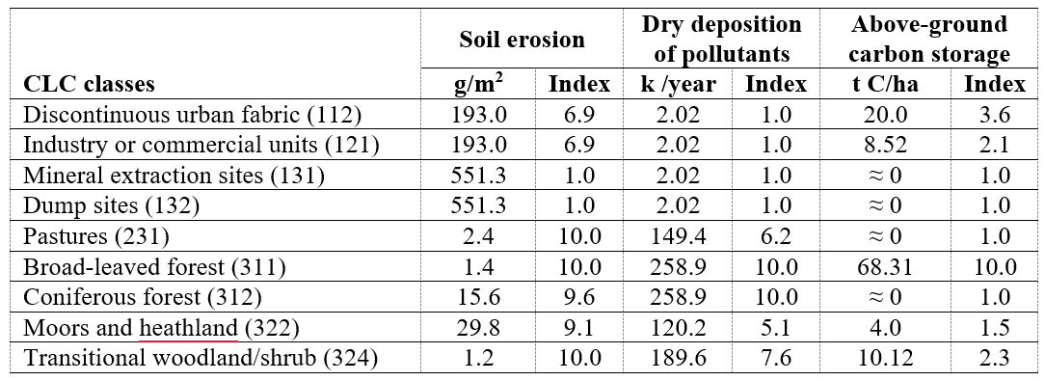
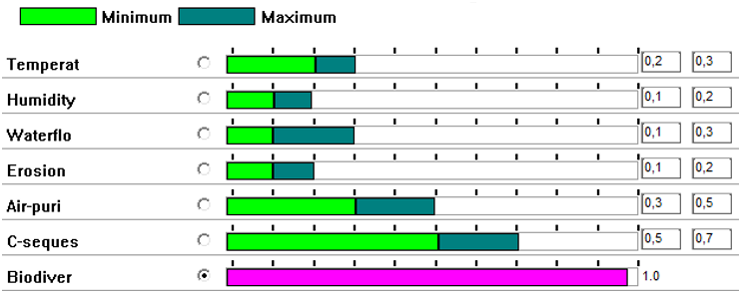
COST-BENEFIT ASSESSMENT
Non-provisioning ecosystem services were quantified before monetising using tables of coefficients for each land cover type derived from field experiments. Then, a reference attribute has been selected (Biodiversity), and the remaining attributes were compared to the reference, considering the specific environment and the local scale used.
Soil erosion, dry deposition of pollutants and above-ground carbon storage for the different CLC classes in Figaredo mine (Spain)
Comparison of ecosystem services relative to the reference attribute (Biodiversity) in Figaredo
Mine (Spain)

Slide 10
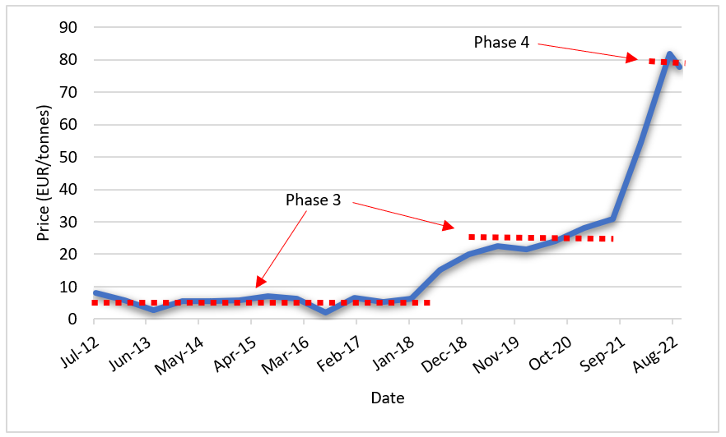
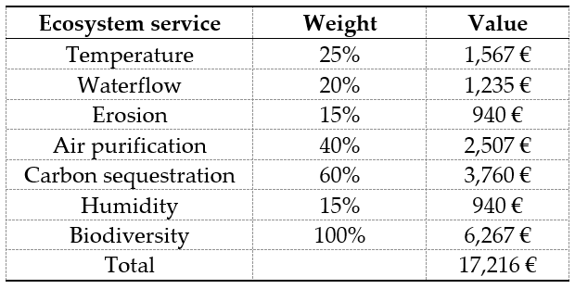
COST-BENEFIT ASSESSMENT
The monetisation of all non-provisioning ecosystem services was built on the monetary valuation of the attribute with the most direct and market‐related valuation possible to achieve consistency: carbon sequestration.
Allowances, which permit the emission of one tonne of carbon dioxide equivalent, were around 25 €/t in 2021 (Phase 3). As 3.67 t of CO2 contain 1 t of C, the average value for the sequestration of 1 t of C can be estimated at 91.75 €/t. This index of 10.0 of Above-ground carbon storage equivalent to 68.31 t C/ha should be valued then at 6,267 €. This value was used as the reference value for ecosystems weighted at 100%.
The value of the highest possible contribution
of ecosystem services per ha

Slide 11
COST-BENEFIT ASSESSMENT
The total value per ha of the considered scenarios is obtained by adding the provisioning ecosystem services value calculated via the net present value (NPV) plus the contribution of non-provisioning eco-system services.
The total values of the different scenarios per ha
However, the implementation of EU ETS Phase 4, which started in 2021, produced an increase in the carbon allowances price of approximately 312%, which led to a drastic change in the proposed valuation of ecosystem services. If you wish to know how we dealt with this question, please refer to:
Krzemień A, Álvarez Fernández JJ, Riesgo Fernández P, Fidalgo Valverde G, Garcia-Cortes S. Restoring Coal Mining-Affected Areas: The Missing Ecosystem Services. International Journal of Environmental Research and Public Health. 2022; 19(21):14200. https://doi.org/10.3390/ijerph192114200

Slide 12
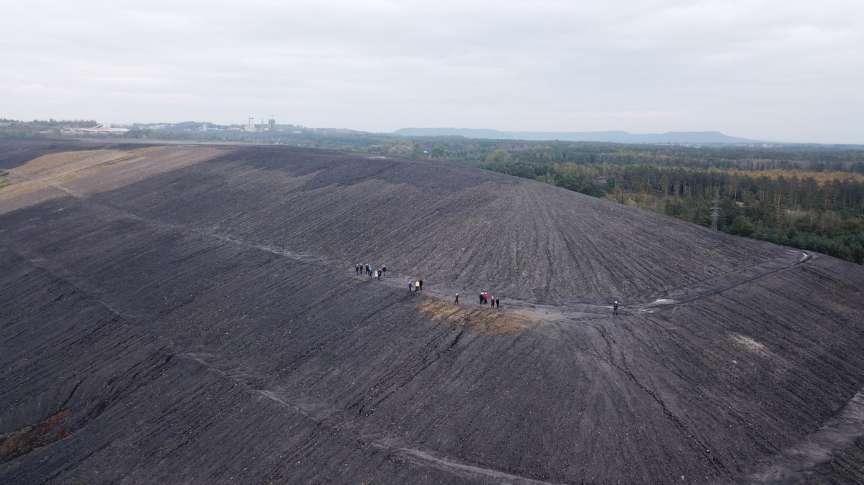
Soil Substitutes for Sustainable Land Reclamation
The Janina Mine is an active coal mine in the south of Poland in Libiąż and property of Tauron Wydobycie S.A.
The waste heap of Janina mine is one of the biggest objects of this kind in the eastern part of Silesian Coal Basin. The wastes stored on the heap cover an area of 80 hectares and reaching the height of 35 metres.

Slide 13
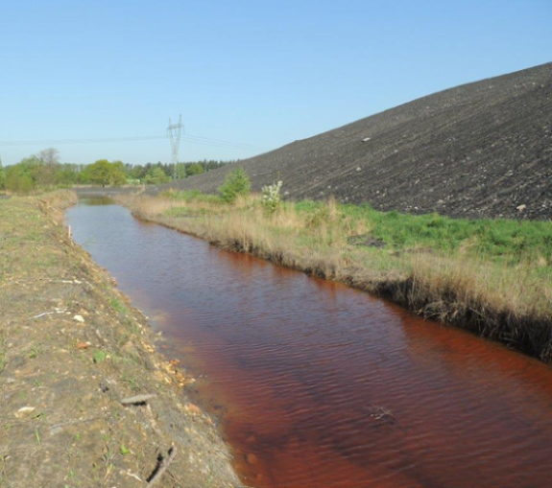
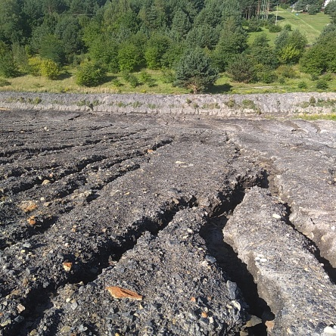
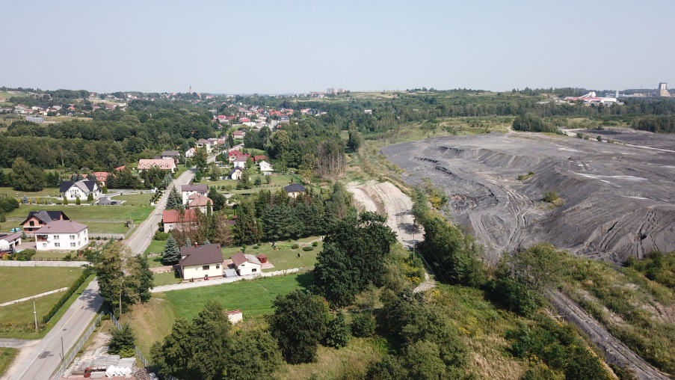
ENVIROMENTAL Problems of Janina Heap
Acid rock drainage from waste dumps contributes to deterioration of the condition of surface water.
Water erosion and waste mass displacements occur on the slopes of the waste heap, which generates costs associated with securing and reinforcing the waste heap.
Wind erosion contributes to the negative impact which waste dumps have on the adjacent areas (including areas of single-family housing).
Negative impact on the aesthetic value of the landscape.
Acid rock drainage
Water erosion
Negative impact on the landscape

Slide 14
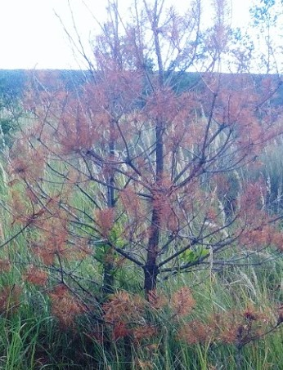
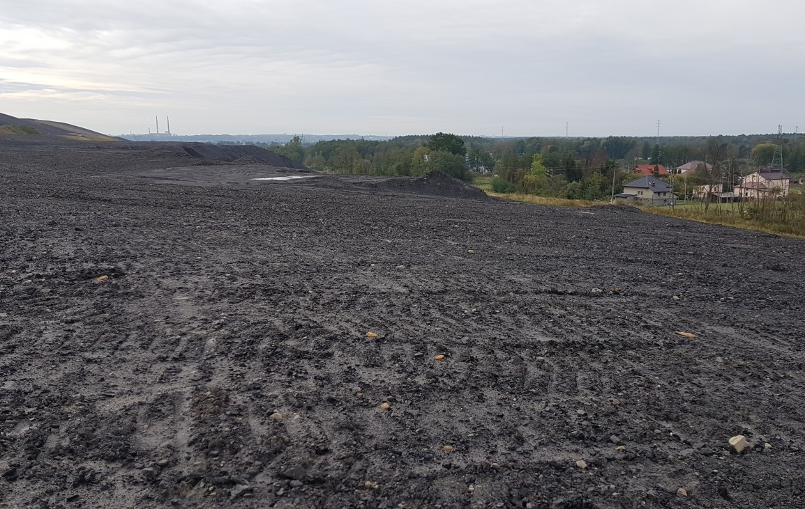
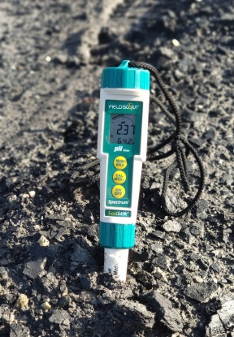
ENVIROMENTAL Problems of Janina Heap
The surface layer of Janina waste heap is the mixture of different mineral grains.
Rainwater in contact with the waste containing pyrite (Fe2S) produces strongly acidified wastewater according to the reaction below:
FeS2 + 3.5 O2 + H2O → Fe2+ + 2 SO42- + 2 H+
Physical and chemical characteristics of the waste render spontaneous vegetation succession on the Janina waste heap impossible.
The measured pH value of the waste heap surface is in range of 2-3

Slide 15
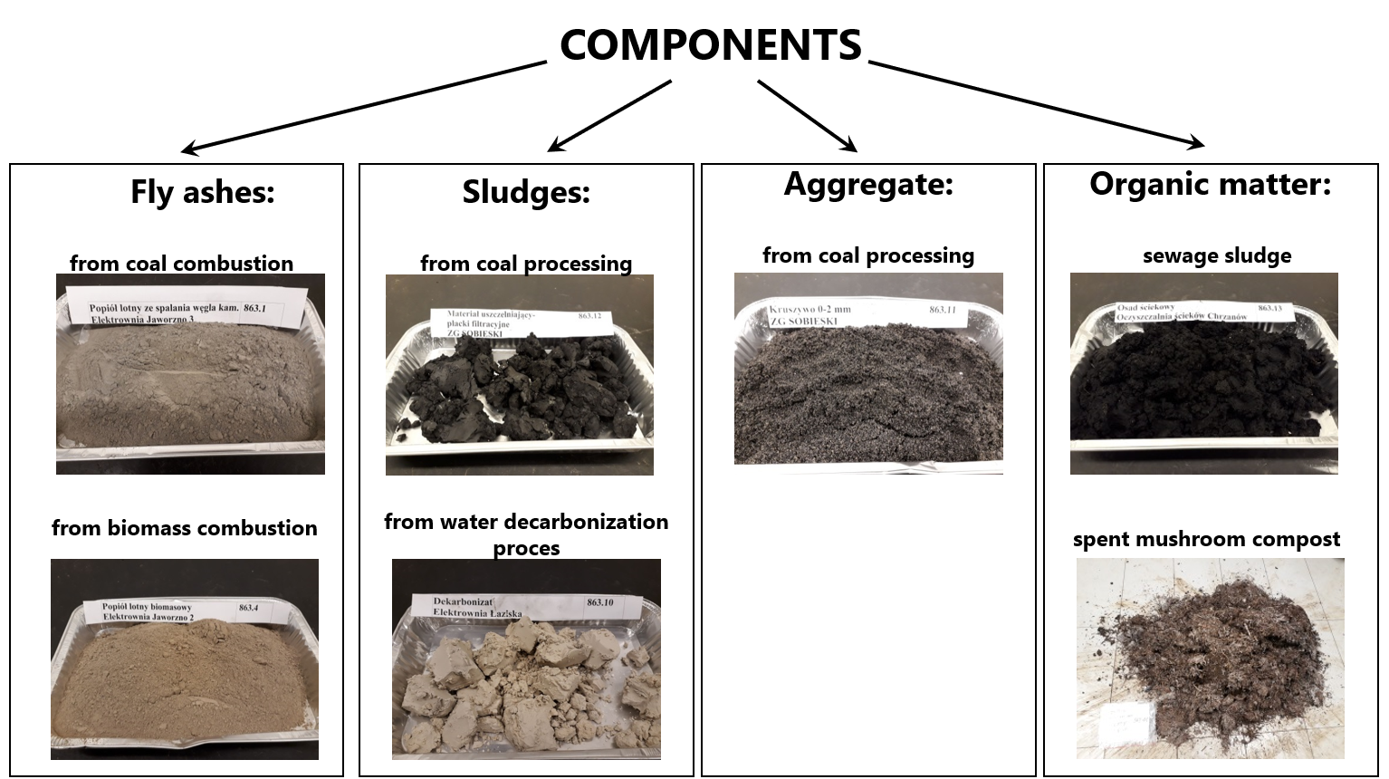
Artificial soil substitutes
Industrial by-products from Coal Mine and Power Plants as well as organic waste were used as components for elaborating soil substitutes blends.

Slide 16
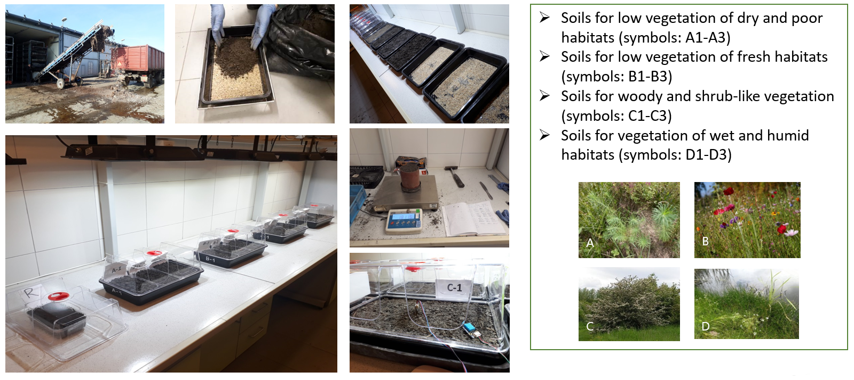
Artificial soil substitutes
Different shares of components allowed preparing 12 soils substitutes blends suitable for different habitats.

Slide 17
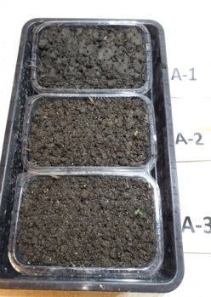
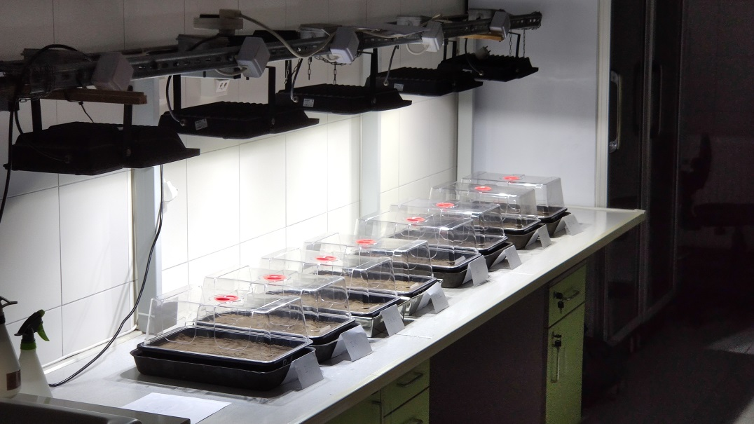
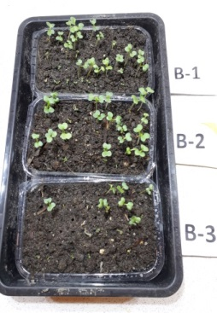
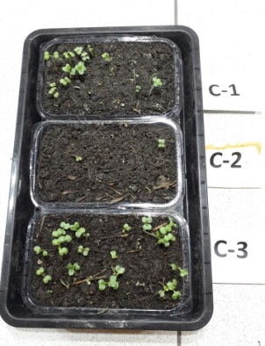
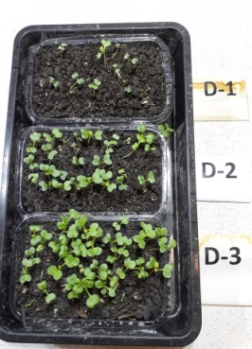
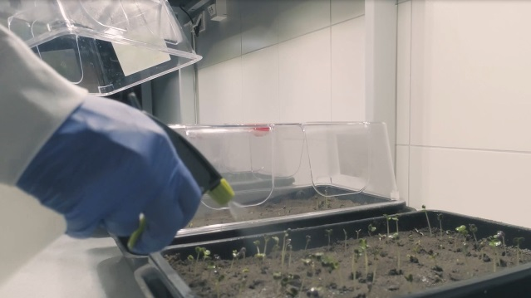
SEED GERMINATION tests
Phytotoxicity test using white mustard (Sinapis alba L.) seeds as a typical test plant was successfully carried out on different mixtures under laboratory conditions: Temperature 22ºC, humidity 30-40%, and white light for 12 hours per day.

Slide 18
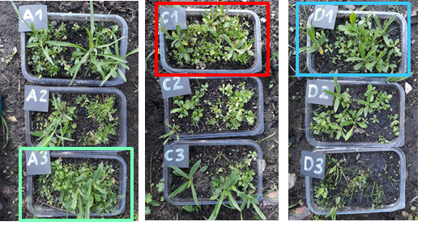
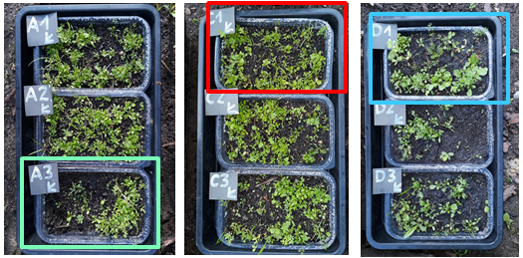
Artificial SOIL SUBSTITUTES SELECTED FOR JANINA MINE
Phytotoxicity test using white mustard (Sinapis alba L.) seeds as a typical test plant was successfully carried out on different mixtures under laboratory conditions: Temperature 22ºC, humidity 30-40%, and white light for 12 hours per day.
Phytotest with flower meadow
Phytotest with dry meadow
Components | (tones) | Soil substitutes (%)
 |  | A3 | C1 | D1
Energetic slag | 324 | 19 | 21 | 17
Decarbonisation lime | 209 | 10 | 10 | 15
Aggregate (0-2 mm) | 309 | 19 | 21 | 18
Sealing material TAURONIT U | 271 | 10 | 10 | 20
Spent mushroom substrate | 580 | 42 | 38 | 30
Total | 1693

Slide 19
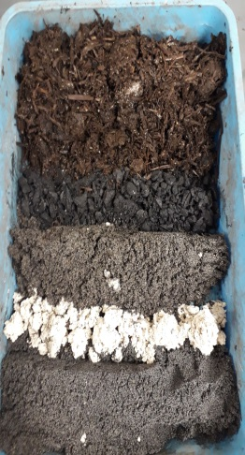
Poligon concept of land rehabilitation
The concept of making an experimental reclamation, cover a fragment of the Janina Mine waste heap in Libiąż (4000 m2) with the use of components, forming layers.
components
Artificial soils substitutes 0.4m
Energetic slag
Artificial soils substitutes
Dolomite aggregate
Decarbonisation lime
Sealing material
Geotextil
Aggregate (0-2mm)
Mixture of soils substitutes
and mine wastes
Crushed dolomite stone
Sealing material
Mine waste
Spent mushroom compost
Mine waste

Slide 20
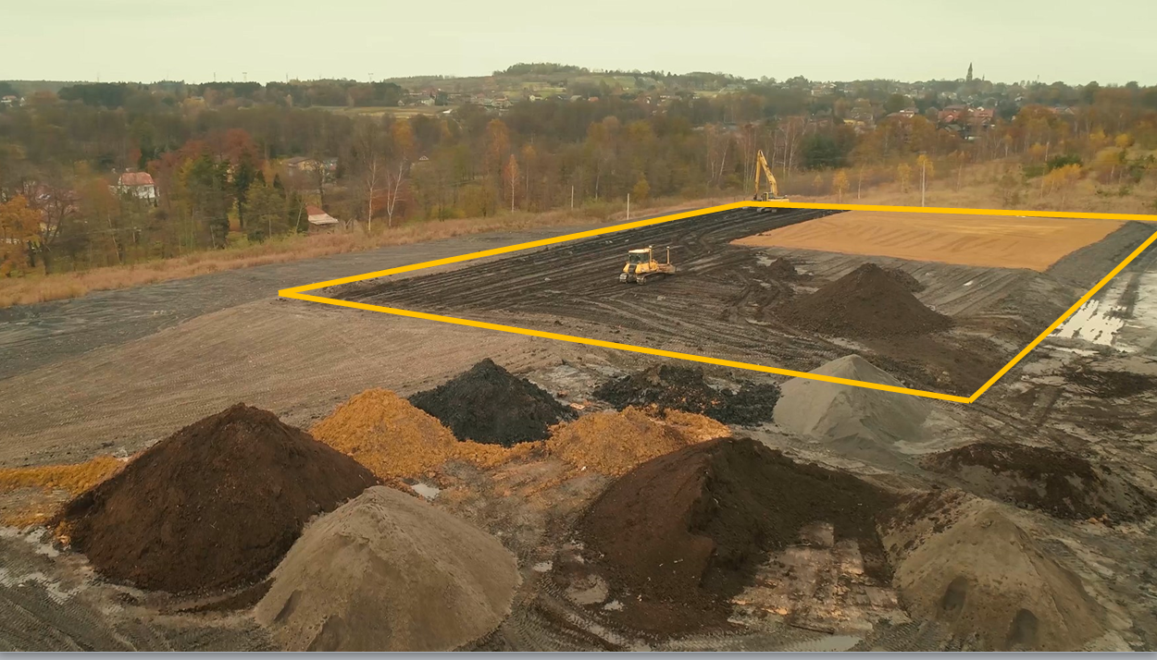
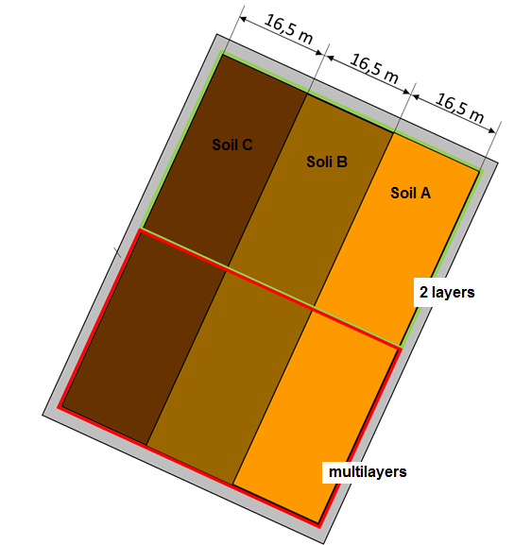
Test poligon in Janina mine waste heap
Poligon was divided into two parts (2-layer and multilayers) according to the concept. Three soil substitutes (A, B, C) were placed on each part of the polygon.

Slide 21
VIDEO OF RECOVERY

Slide 22
THANK YOU FOR YOUR ATTENTION
Prof. Alicja Krzemień
Head of Laboratory of Risk Assessment and Industrial Safety
Department of Extraction Technologies, Rockburst and Risk Assessment
Plac Gwarków 1 40-166 Katowice Poland phone: +48 32 259 2556 akrzemien@gig.eu

