Slide 1
Site specific challenges within the project: German experience of reclamation techniques from the Region south of Leipzig
Prof. Dr. Dagmar Haase & Dr. Peer von Döhren
Humboldt-Universität zu Berlin
1

Slide 2
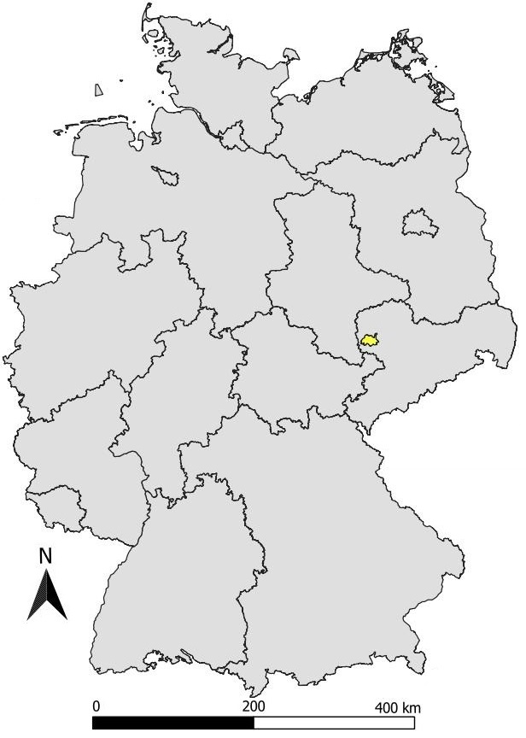
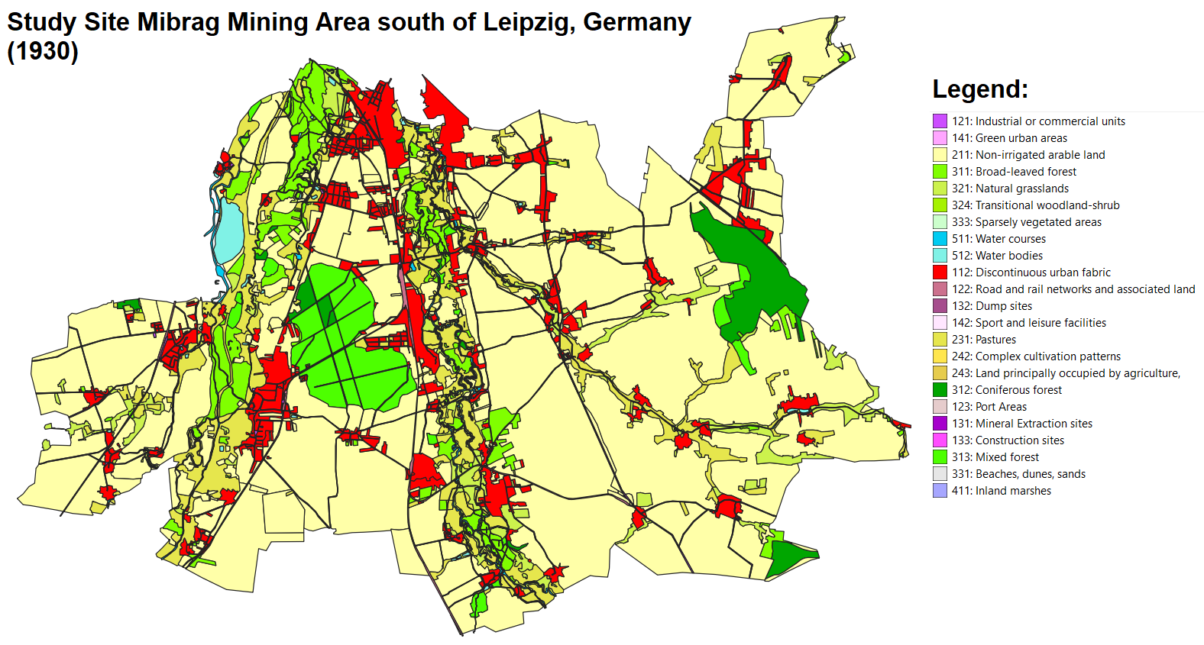
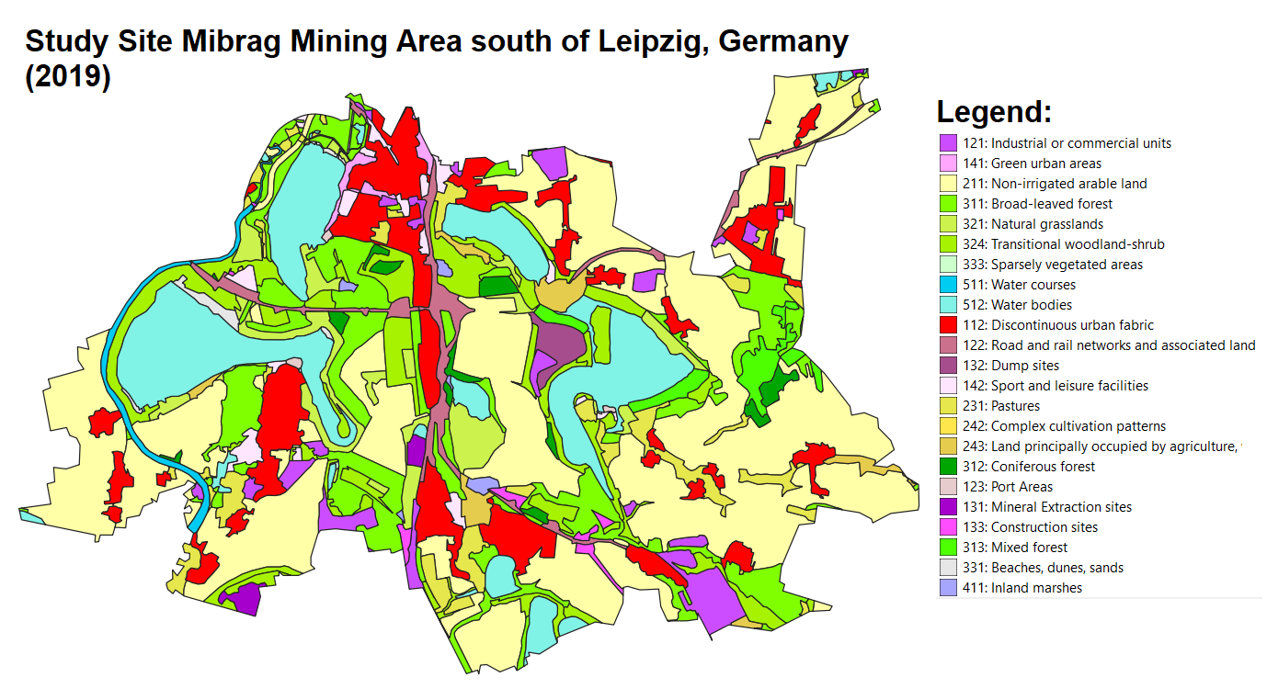
2

Slide 3
Changes in the pre and post mining landscape:
More artificial lakes (former mining pits)
More hills (former mining dump heaps)
More transitional land cover: transitional mixed woodland, grassland
More settlement areas
More industrial areas
Less arable land (agriculture)
More diversity in land cover types:
Ecosystems
Development options/opportunities
3

Slide 4
Artificial lakes as new unique landscape elements:
Cospudener See
Markkleeberger See
Störmthaler See
Zwenkauer See
4

Slide 5
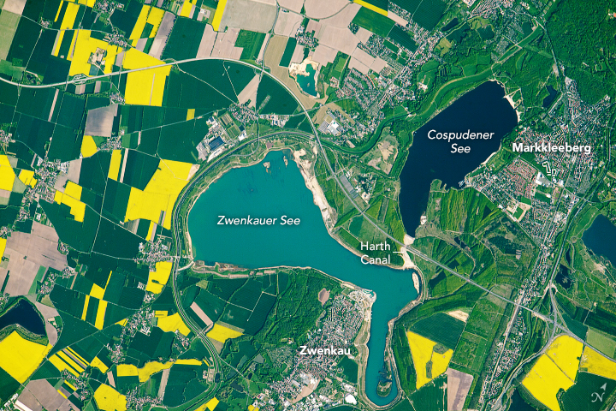
Post mining landscape: Ecosystem Services
Agricultural Production – Landscape experience – Recreation/ Watersports:
Cospudener See
Zwenkauer See
Image: NASA (https://earthobservatory.nasa.gov/images/92200/a-transformed-landscape-in-germany)
5

Slide 6
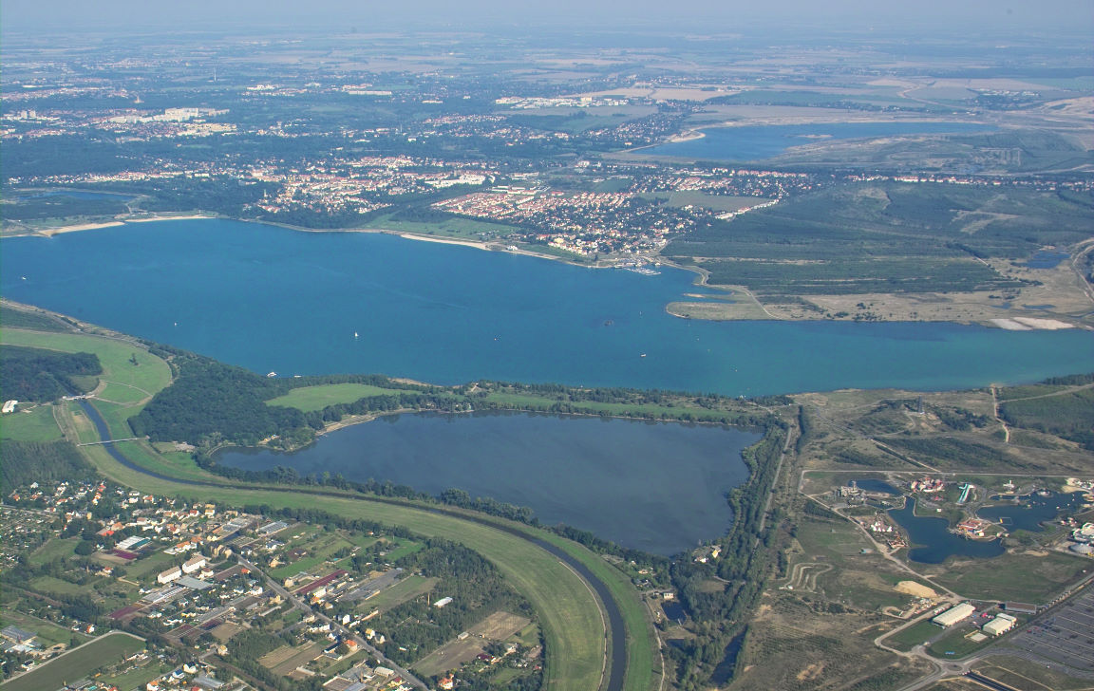
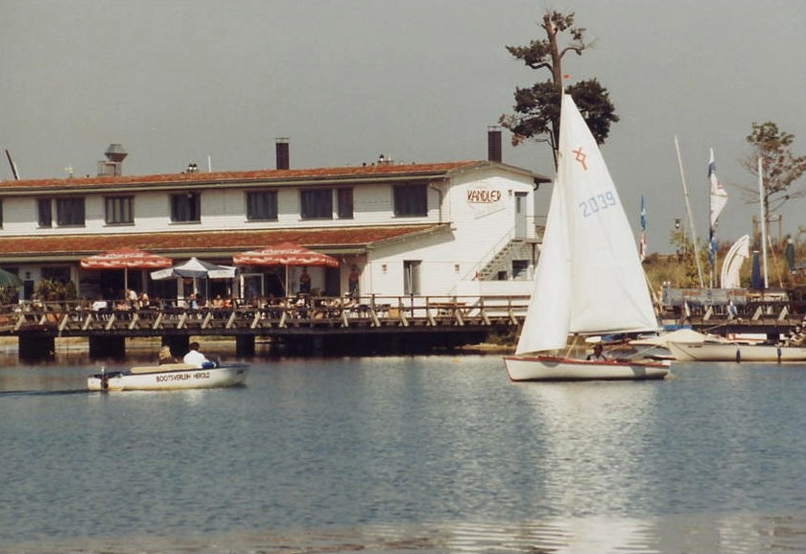
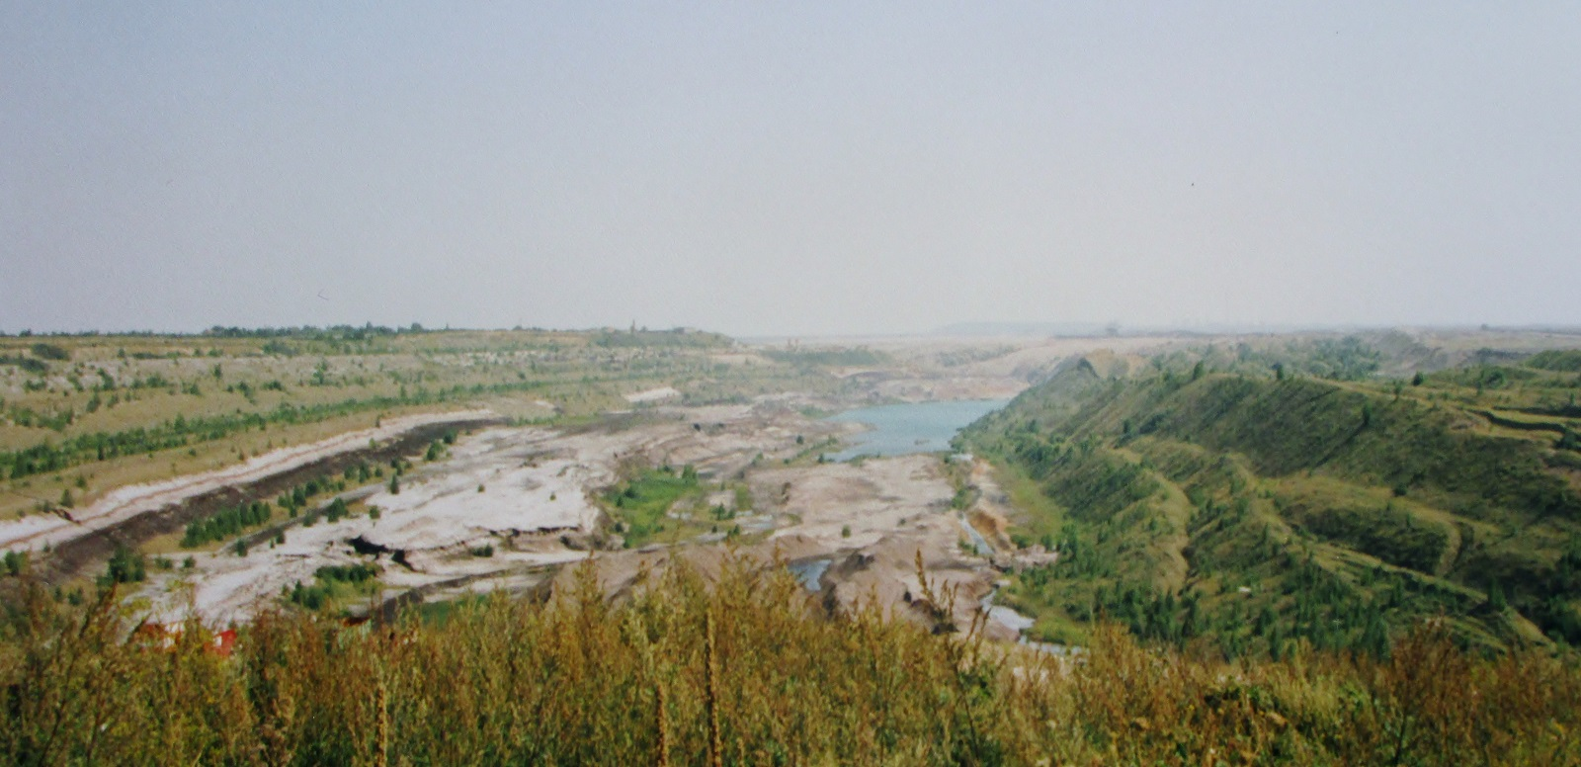
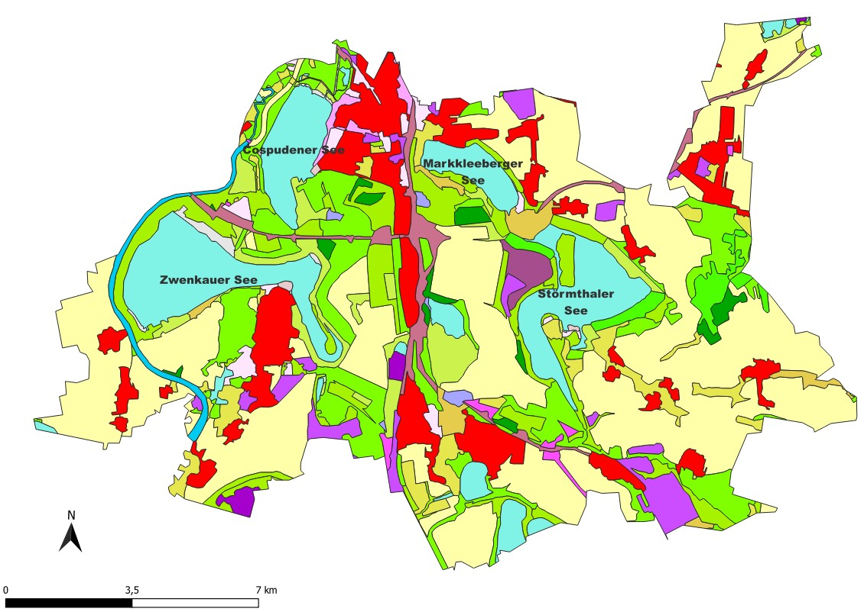
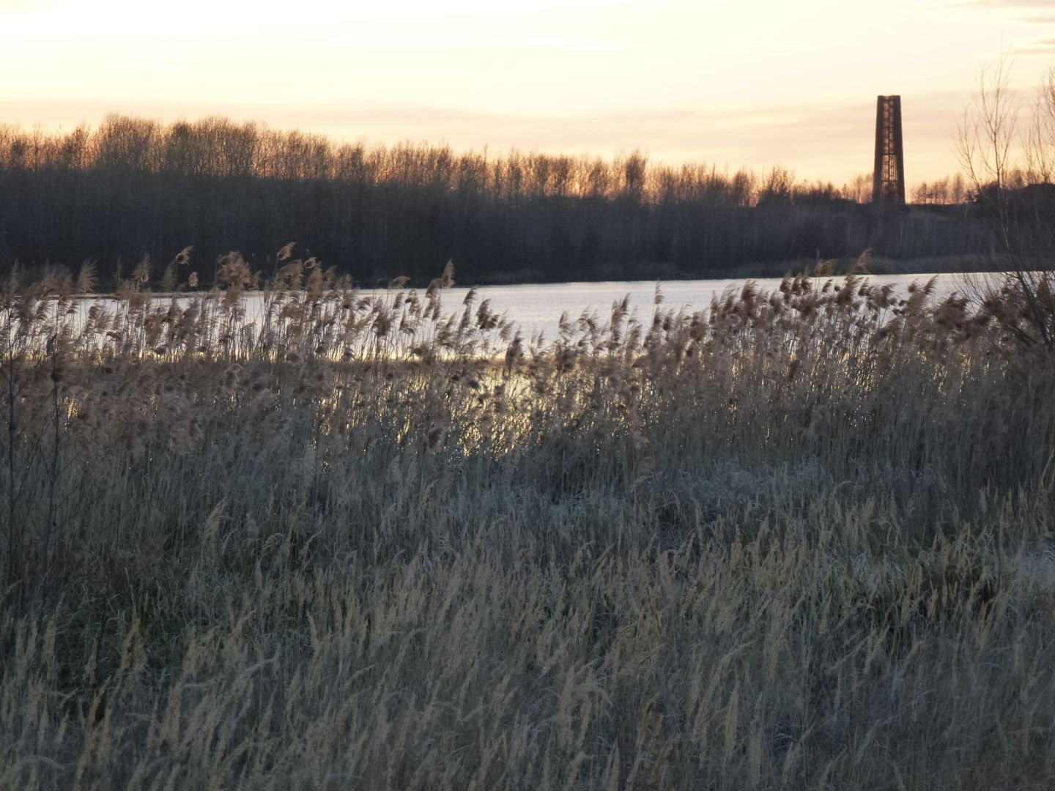
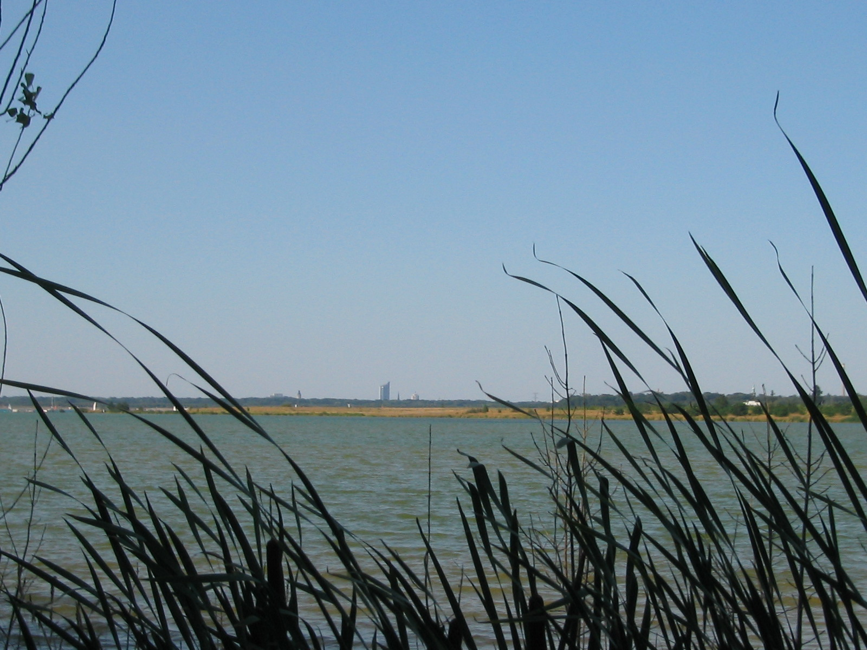
Mining-pit Cospuden 1993
Cospudener See
Image: Andreas Wolf 01 - Eigenes Werk, CC BY-SA 4.0, https://commons.wikimedia.org/w/index.php?curid=110860724
Image: Andreas Hannusch, CC BY-SA 3.0, https://commons.wikimedia.org/w/index.php?curid=12984938
Image: Norbert Kaiser - Eigenes Werk, CC BY-SA 3.0, https://commons.wikimedia.org/w/index.php?curid=884091
Image: Tnemtsoni - Eigenes Werk, CC BY-SA 3.0, https://commons.wikimedia.org/w/index.php?curid=31741126
Image: Daniel-obst, CC BY-SA 3.0, https://commons.wikimedia.org/w/index.php?curid=11685794
6

Slide 7
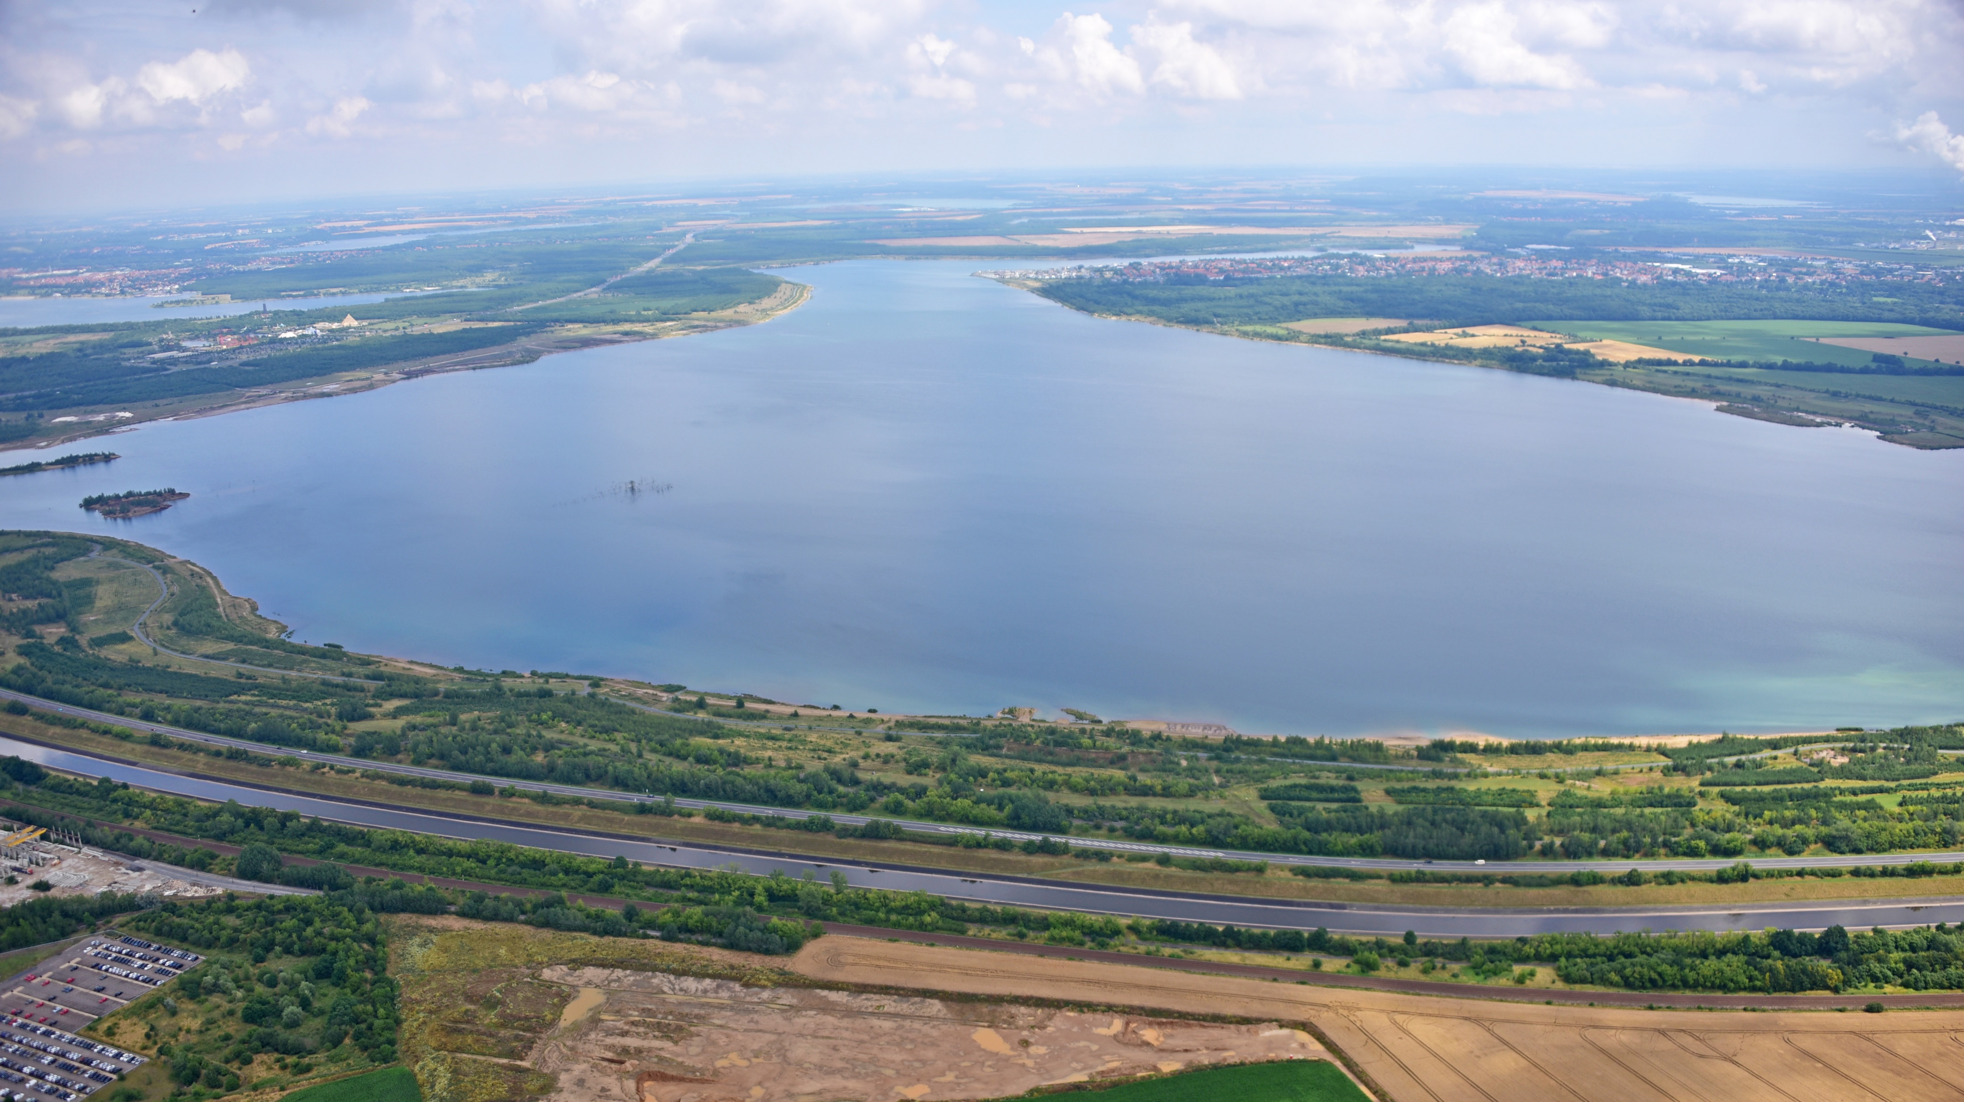
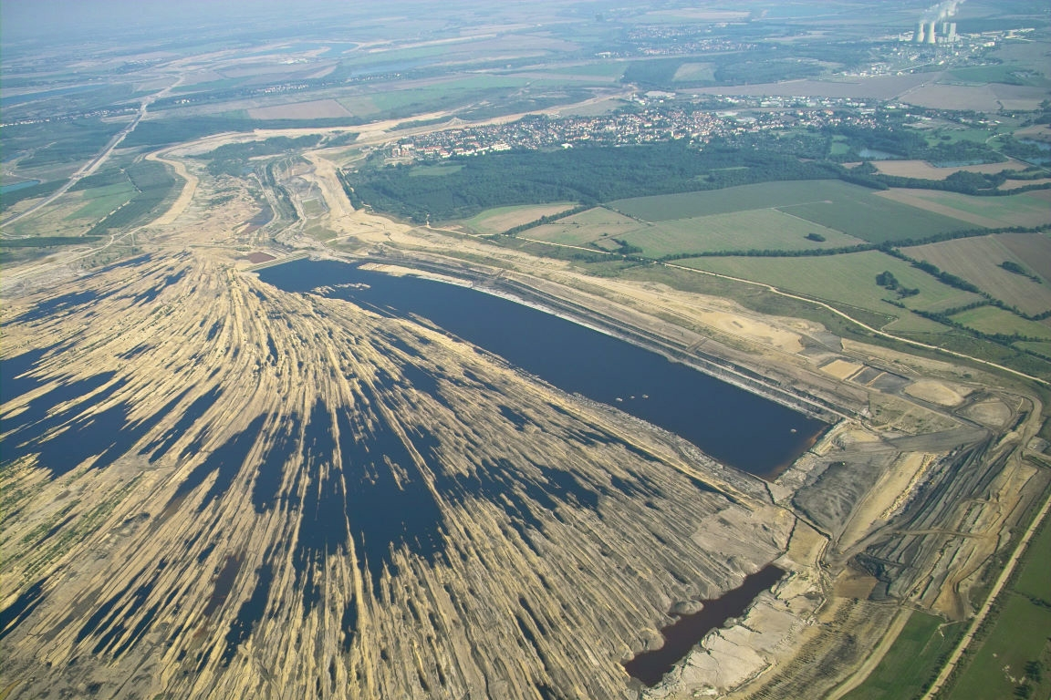
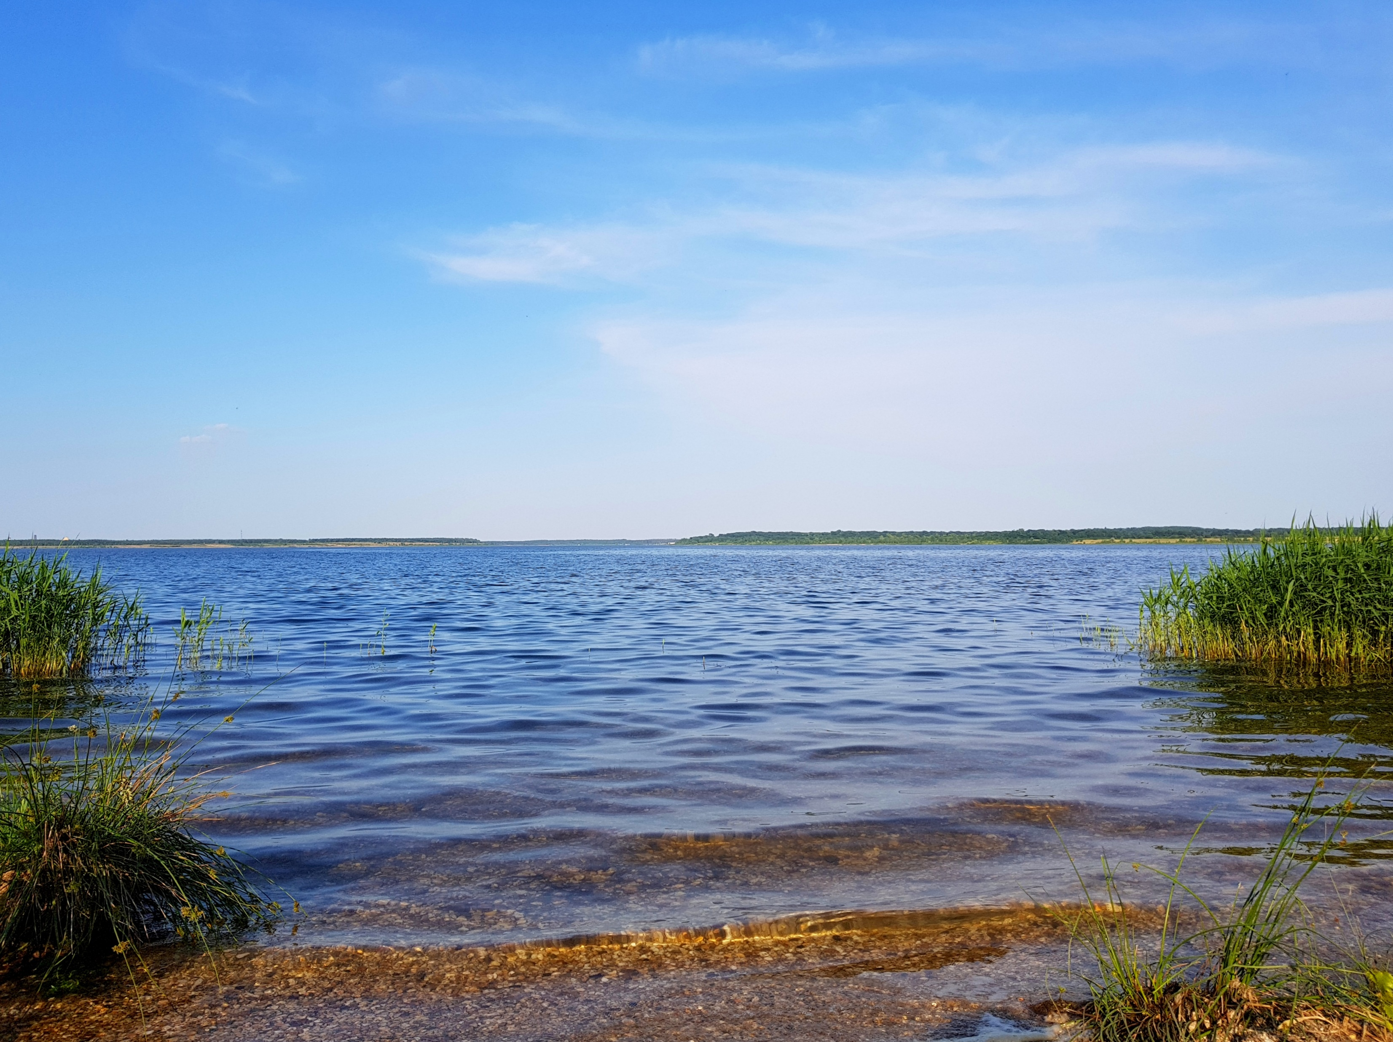
Zwenkauer See
Pit-mine Zwenkau, 2005
Image: Wolkenkratzer - Eigenes Werk, CC BY-SA 4.0, https://commons.wikimedia.org/w/index.php?curid=61294012
Von Daniel Sporbert - Zwenkauer-See.wiki, CC BY-SA 4.0, https://commons.wikimedia.org/w/index.php?curid=69884672
Image: Andreas Hannusch, CC BY-SA 3.0, https://commons.wikimedia.org/w/index.php?curid=8836413
Image: Daniel Sporbert - Zwenkauer-See.org, CC BY-SA 4.0, https://commons.wikimedia.org/w/index.php?curid=71169741
7

Slide 8
Landscape Ecosystem Services
Biodiversity – Landscape based Tourism – Cultural heritage:
Markkleeberger See
Störmthaler See
8

Slide 9
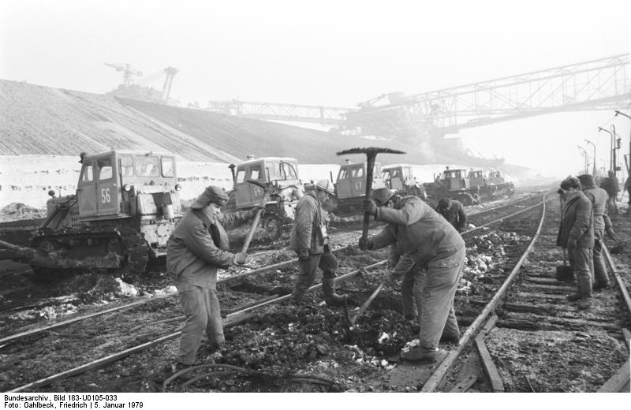
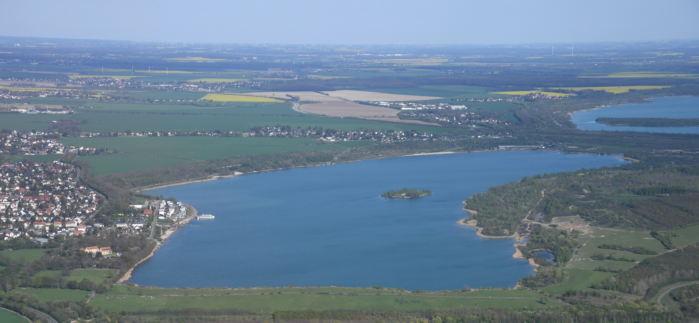
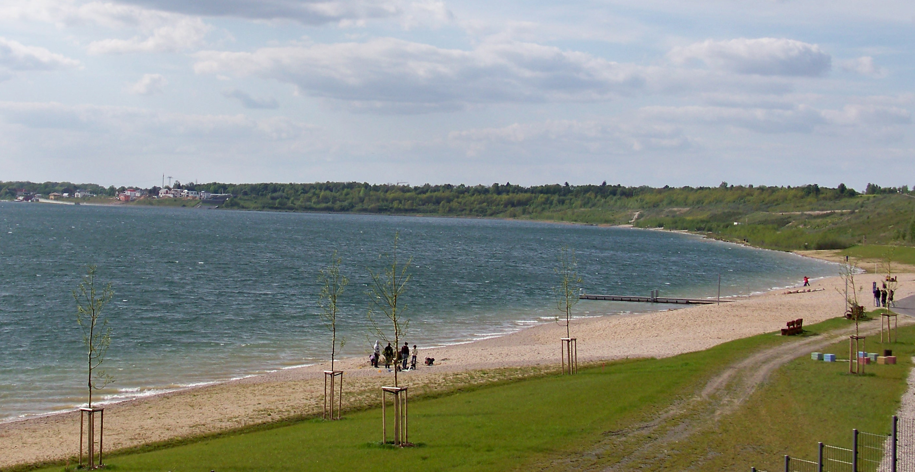
Pit-mine Espenhain (Markkleeberg) 1979
Markkleeberger See
Image: Bundesarchiv, Bild 183-U0105-033 / Gahlbeck, Friedrich / CC-BY-SA 3.0, CC BY-SA 3.0 de, https://commons.wikimedia.org/w/index.php?curid=5437437
Image: Carsten Steger - Eigenes Werk, CC BY-SA 4.0, https://commons.wikimedia.org/w/index.php?curid=105256200
Image: Joeb07 - Eigenes Werk, CC BY-SA 3.0, https://commons.wikimedia.org/w/index.php?curid=10351967
Image: Joeb07 - Eigenes Werk, CC BY-SA 3.0, https://commons.wikimedia.org/w/index.php?curid=10351857
9

Slide 10
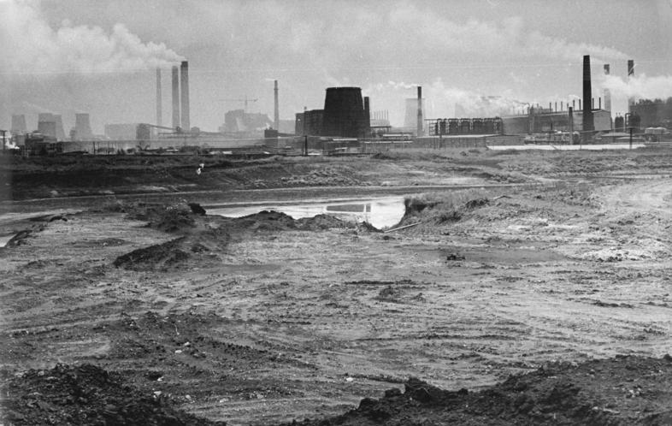
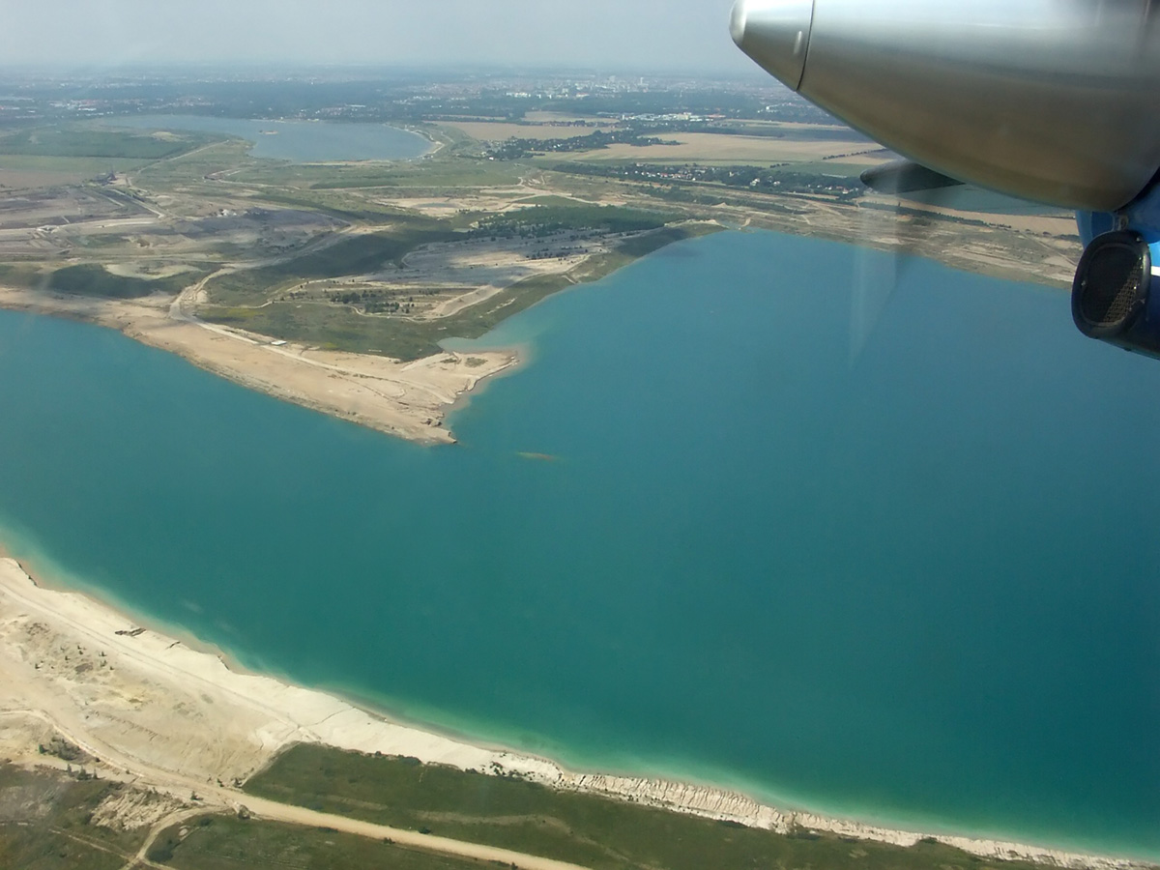
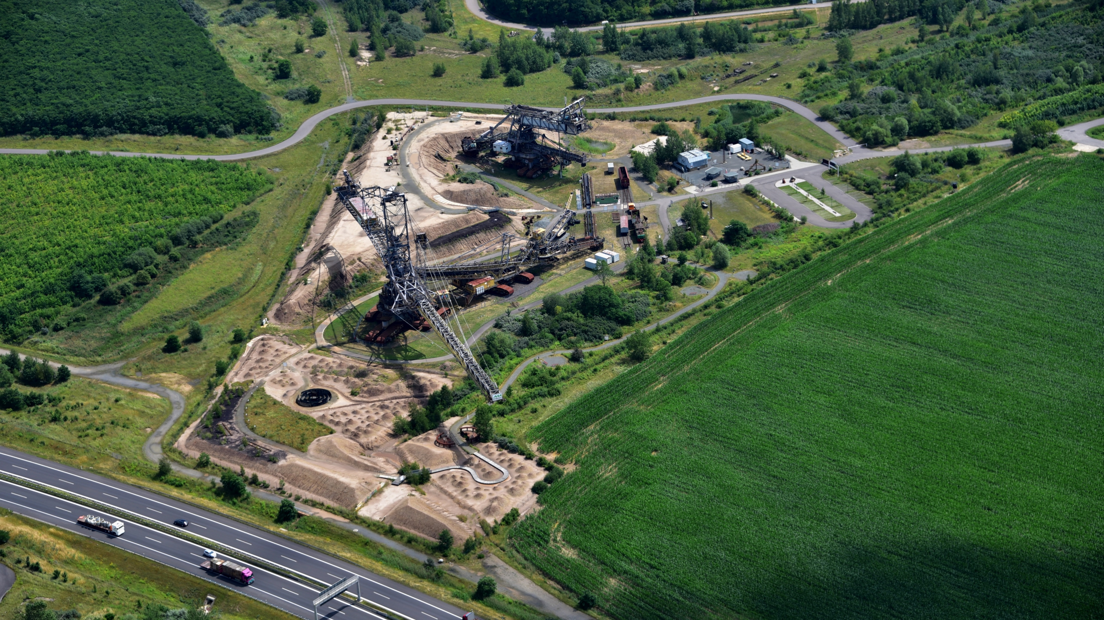
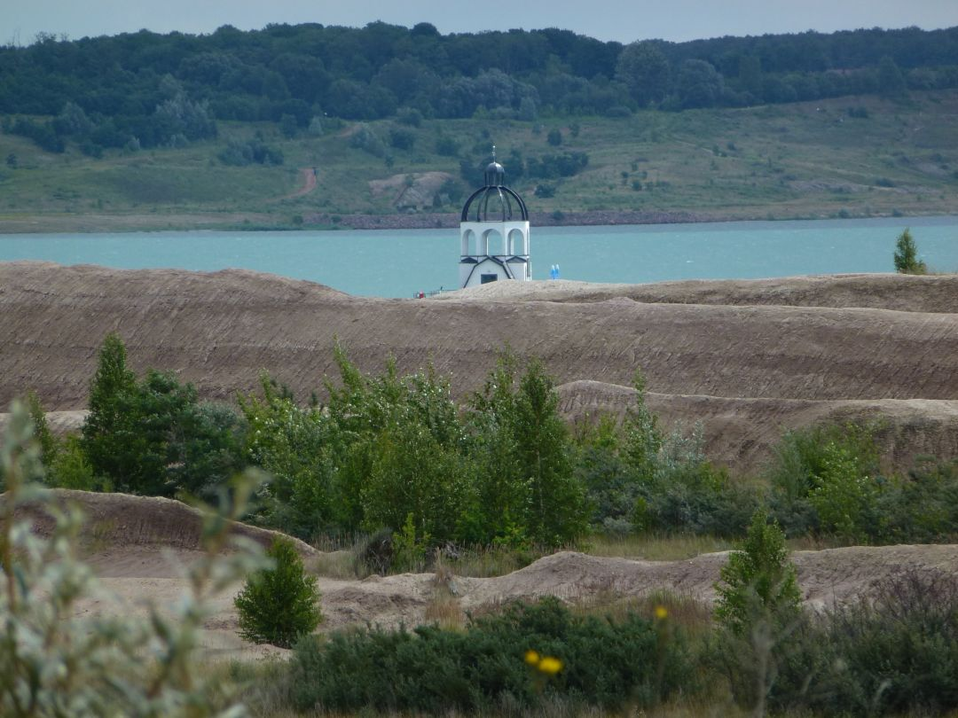
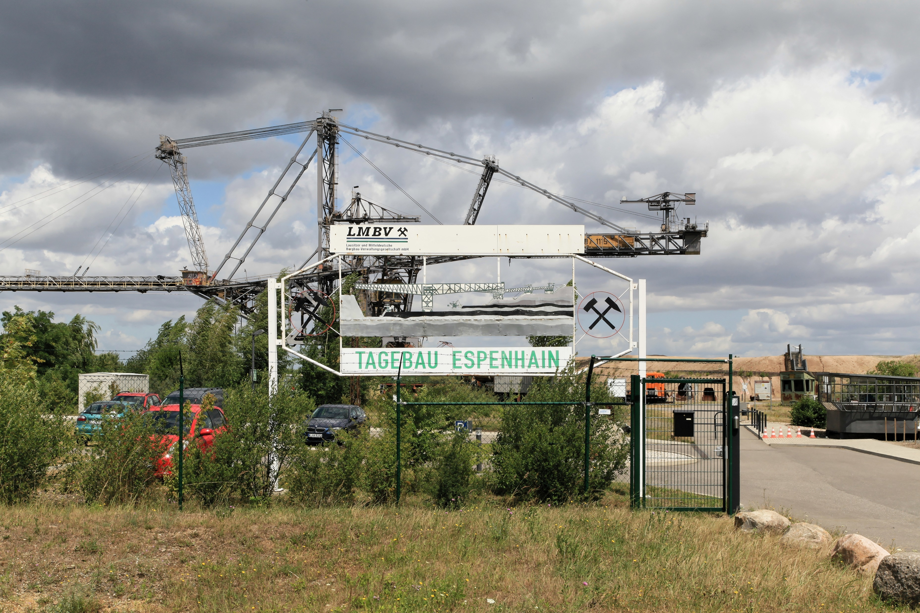
Störmthaler See
Lignite Refinery, Espenhain 1990
Open-air Mining Museum (west of the Störmthaler See)
Image: Wolkenkratzer - Eigenes Werk, CC BY-SA 4.0, https://commons.wikimedia.org/w/index.php?curid=61250426
Image: Bundesarchiv, Bild 183-1990-0713B-021 / Grubitzsch (geb. Raphael), Waltraud / CC-BY-SA 3.0, CC BY-SA 3.0 de, https://commons.wikimedia.org/w/index.php?curid=5347989
Image: Martin Geisler, CC BY-SA 3.0, https://commons.wikimedia.org/w/index.php?curid=23261930
Image: Tnemtsoni - Eigenes Werk, CC BY-SA 3.0, https://commons.wikimedia.org/w/index.php?curid=20276755
Image: Frank Vincentz - Eigenes Werk, CC BY-SA 3.0, https://commons.wikimedia.org/w/index.php?curid=51059893
10

Slide 11
Thank you for your kind attention.
11

