Slide 1
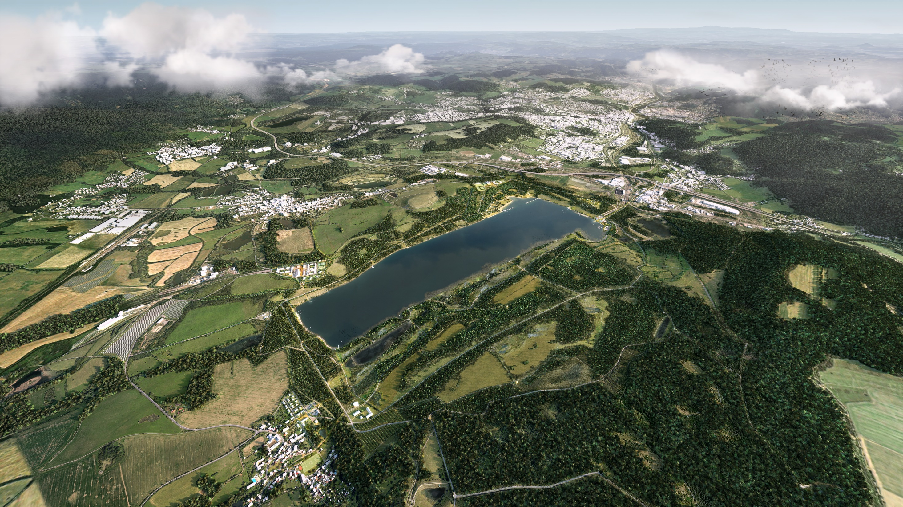
Vision for Lake Milada

Slide 2
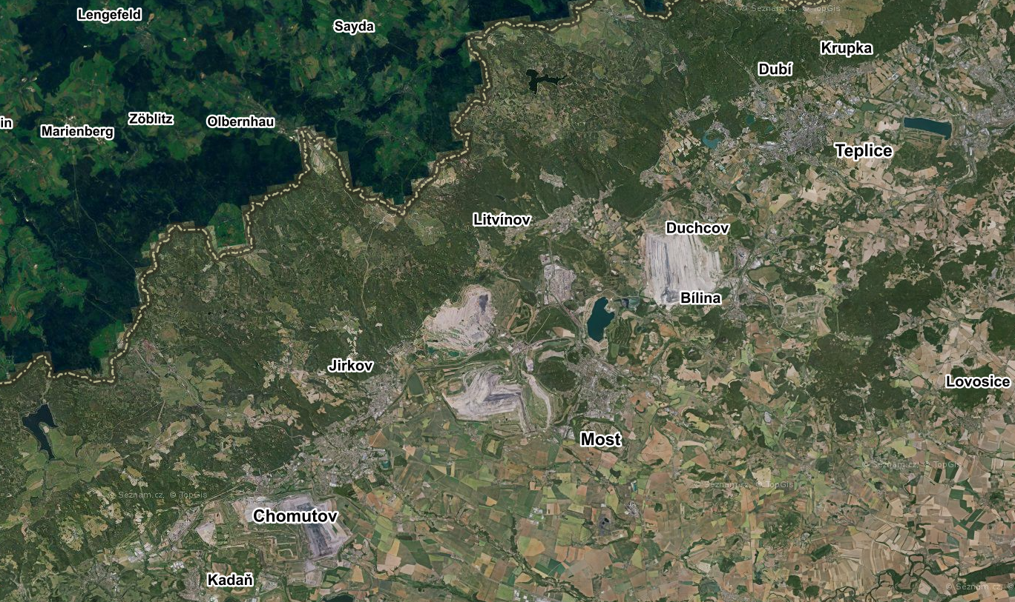
Completed hydraulic reclamation
Ongoing mining

Slide 3
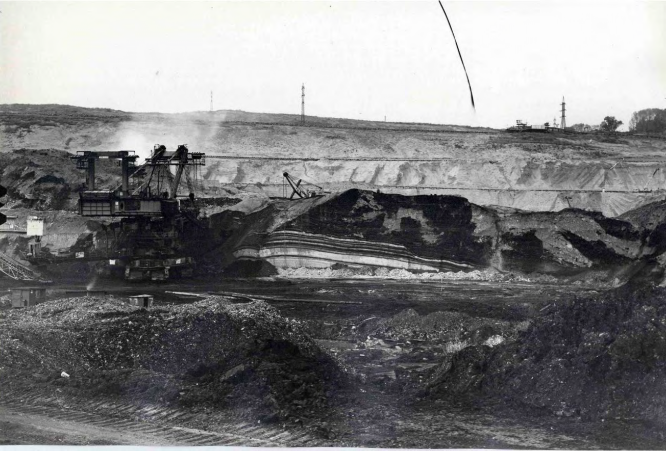
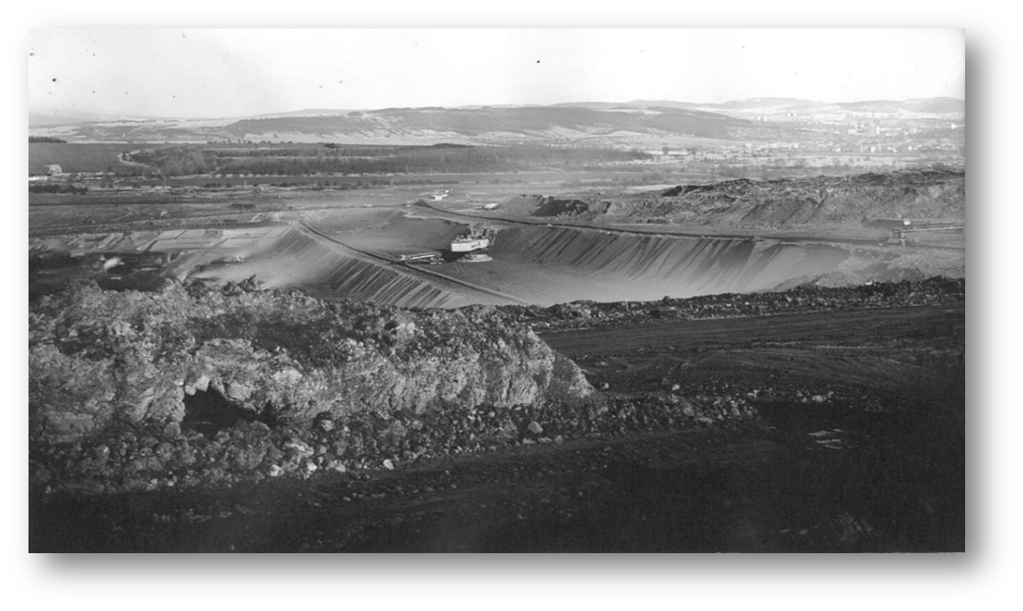
CHABAŘOVICE MINE - HISTORY
1977 – start of mining with large machine technology
1991 – the quarry was classified as a reduction mine and quarries
1993 – prepared and approved the Technical and Social Project for the Liquidation of the Chabařovice Quarry.
1997 – all brown coal mining and processing ended
annual production was 5 million tons of brown coal
total of 61 million tons of coal were mined
the demise of 6 municipalities: Vyklice, Hrbovice, Tuchomyšl, Otovice, Lochočice, Žichlice

Slide 4
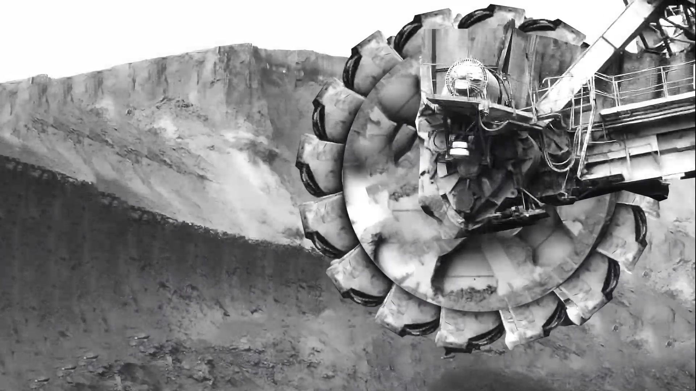
VIDEO

Slide 5
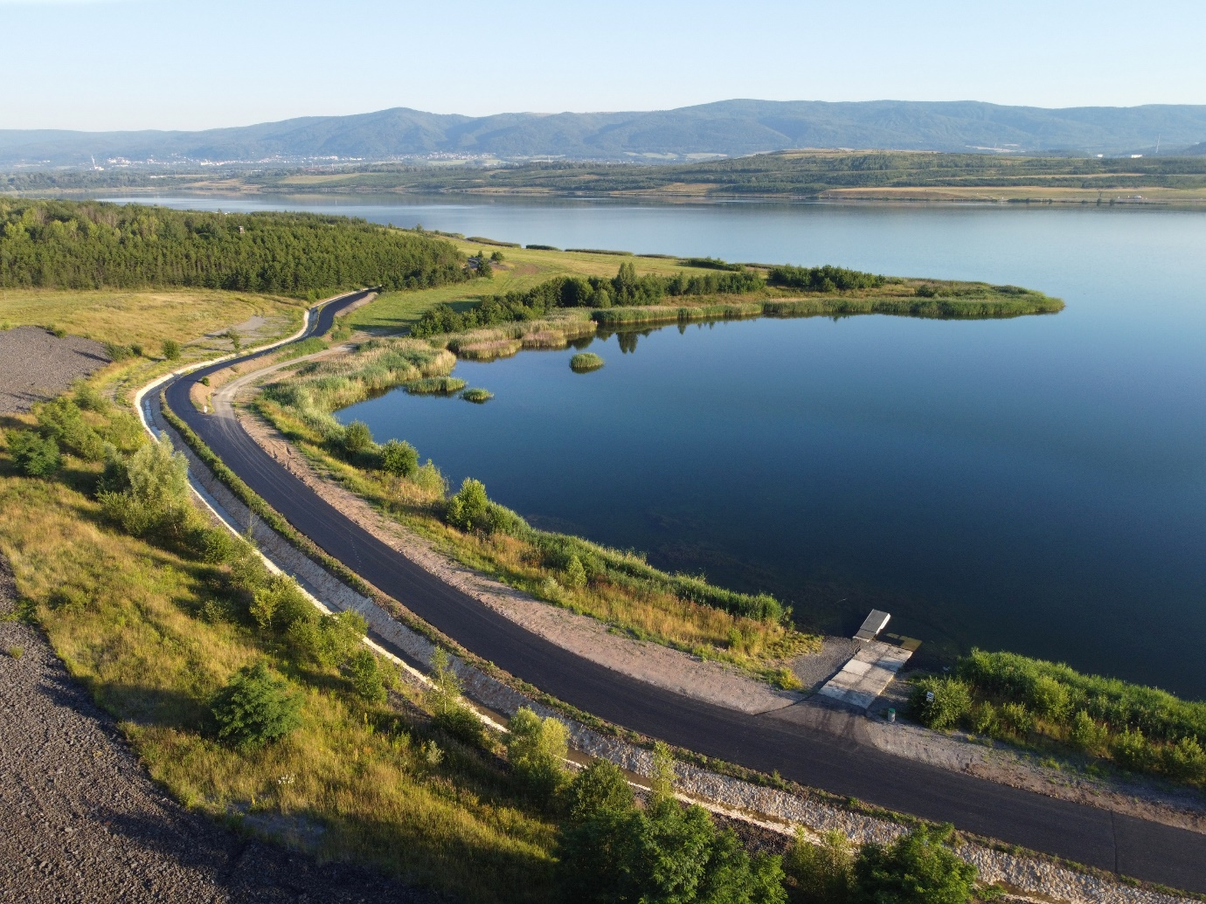
CONCEPTUAL STUDY OF THE AREA OF LAKE MILADA
Due to the lack of a concept for the further development an area of the interest of Lake Milada, in 2019 it was decided to announce an open International Landscape, Urban and Architecture Design Competition.
On 15 June 2021 as a winner was announced the Swedish landscape studio Mandaworks AB.
Subsequently, a Cooperation Agreement was concluded with the winner of the competition for the processing of:
Conceptual study of the Milada Lake area
Design Manual
PD for 3 architectural interventions in the territory
Consulting until 2030

Slide 6
LIVING LANDSCAPE CONCEPT
Living landscape:
Harmonious development of nature and recreation
Nature X Recreation
For future development, it is important to ensure that the landscape as a resource is not “exploited by human recreation” again. In the design of the living landscape, we therefore emphasize the development of the values both within the area and in its surroundings and protect the landscape, so it is not abused by new content at the expense of the quality of the environment. The proposal strengthens and develops the existing ecology of the landscape, directly affecting and improving the environment for the surrounding inhabitants.

Slide 7
PREPARATION OF FIRST REALIZATIONS IN THE AREA
Among the first realizations in the area are three buildings in the landscape.
These are the Picnic shelter by the main beach, the Facility in the Trmice beach and the Elevated shelter on the western slopes above the lake.
The next stage that follows is the transfer of the territory to a new administrator, which is the municipality.

Slide 8
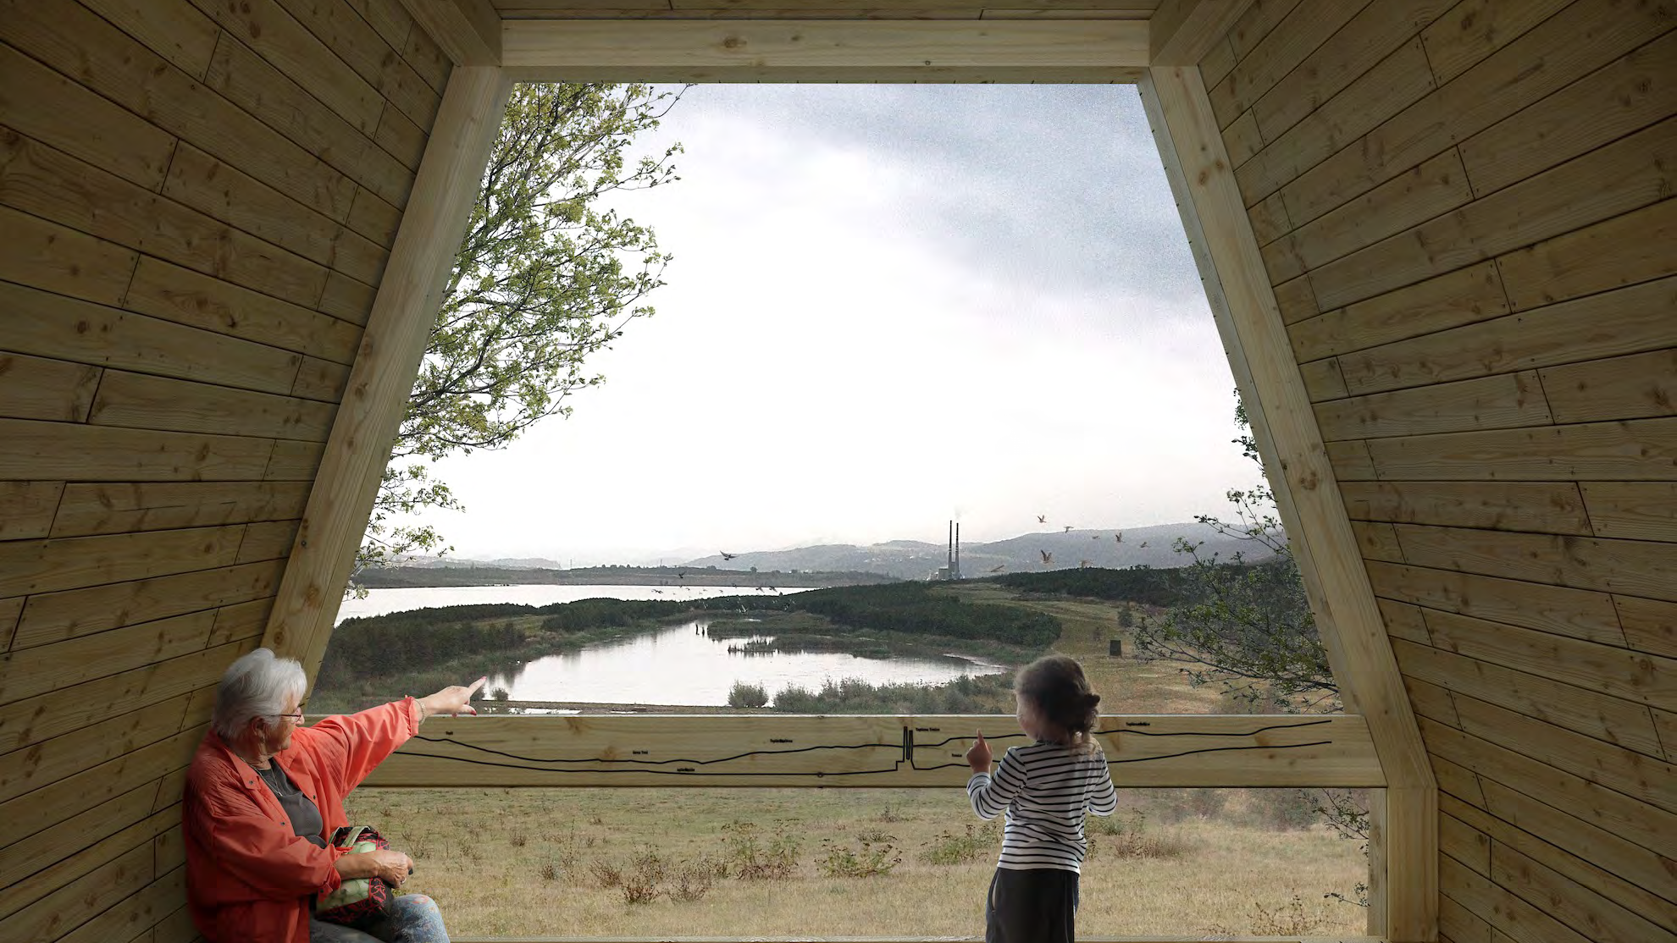
Thank you for your attention.

