Slide 1
Circular Economy in GIG activities
European research project RECOVERY (07/2019 - 06/2023):
“Recovery of degraded and transformed ecosystems in coal mining-affected areas”
Research Fund for Coal and Steel (847205-RECOVERY-RFCS-2018)
and the Polish Ministry of Science and Higher Education (5036/FBWiS/2019/2)
prof. Alicja Krzemień

Slide 2
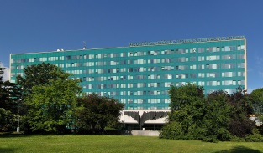
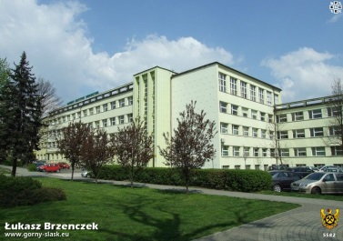
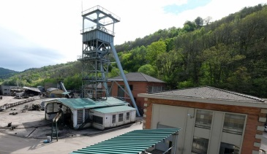
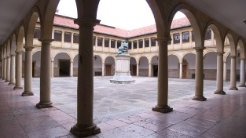
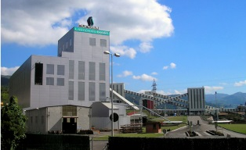
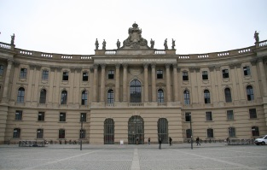
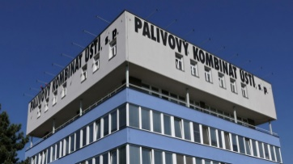
RECOVERY - INDIVIDUAL PARTNERS OF THE CONSORTIUM
1. Główny Instytut Górnictwa (Central Mining Institute) (GIG), Poland - coordinator
2. Universidad de Oviedo (UNIOVI), Spain
3. Humboldt Universität zu Berlin (UBER), Germany
4. Vysoka Skola Banska-Technicka Univerzita Ostrava (VSB), Czech Republic
5. Hulleras Del Norte SA (HUNOSA), Spain
6. Tauron Wydobycie SA (TWD), Poland
7. Palivový kombinát Ústí, státní podnik (PKÚ), Czech Republic
4
3
1
7
5
2
2
1
6
6
3
5
4
7

Slide 3
AIM OF THE PROJECT
RECOVERY project focuses on land rehabilitation and ecological restoration of coal mining-affected areas, aiming to accelerate the recovery of degraded and transformed ecosystems to a good ecosystem status.
It will assess the contribution of these ecosystems to human wellbeing by means of the “ecosystem-services” concept, evaluating the consequences of alternative courses of action to ensure their capacity to provide benefits to society is not diminished.

Slide 4
PROJECT’S METHODOLOGY
Coal mining-affected areas in different stages of restoration
Quantify and map ecosystem services provision
current state
Quantify and map ecosystem services provision
Land rehabilitation and ecological restoration alternatives
scenario A
scenario B
Quantify and map ecosystem services provision
Quantify
the economic value of ecosystem services
Quantify
costs of
actions
Land rehabilitation
and ecological restoration options which deliver the greatest benefits relative to their investment and maintenance cost

Slide 5
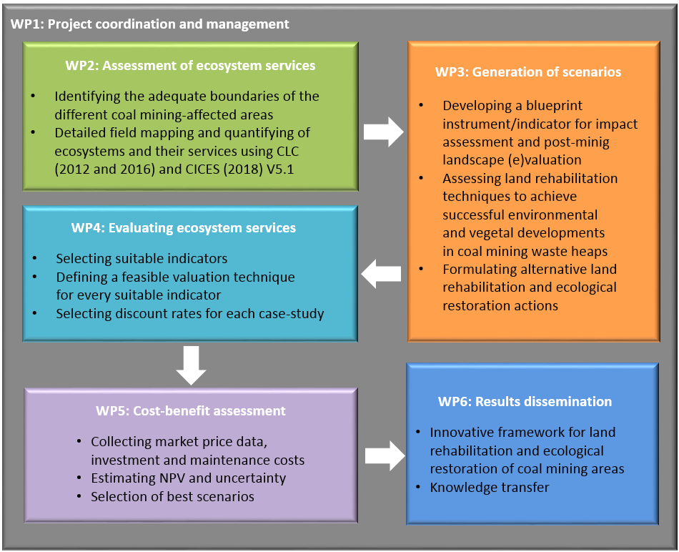
RECOVERY’s implementation plan

Slide 6
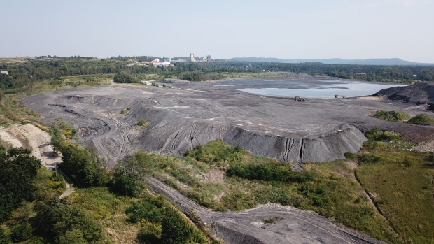
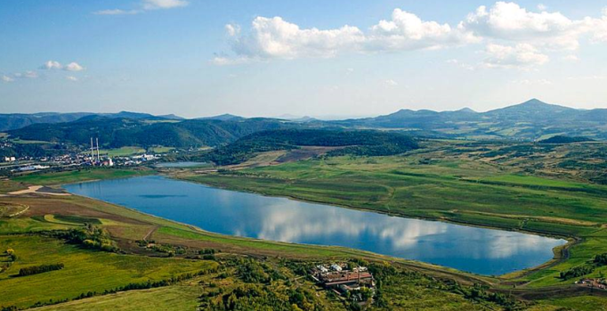
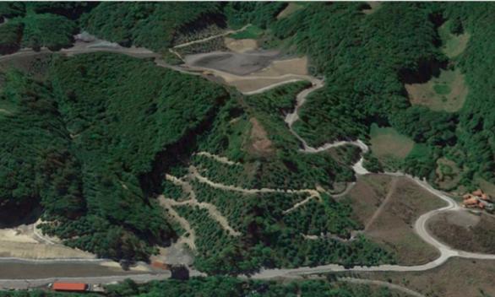
RESEARCH AREAS of recovery project
The coal mining-affected areas of the Recovery Project
Janina Mine (Silesia, Poland)
Chabařovice Mine
(Bohemia, Czech Republic)
Figaredo Mine
(Asturias, Spain)
The Terezie - Ema mine dumps
Complex (Silesia, Czech Republic)
Mibrag Mines
(South of Leipzing, Germany)
Most-Ležáky Mine
(Bohemia, Czech Republic)

Slide 7
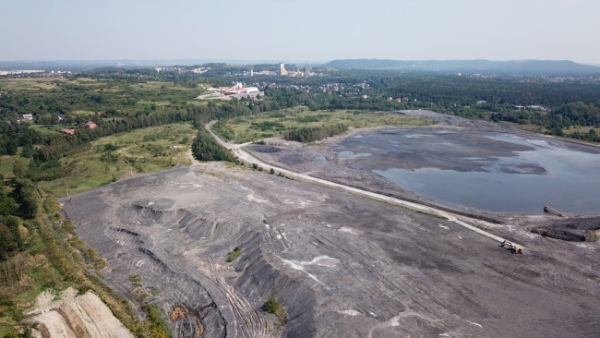
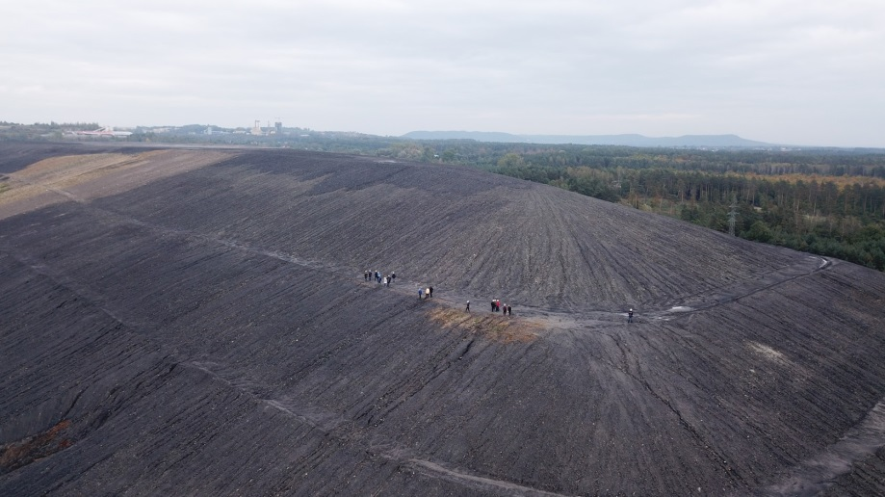
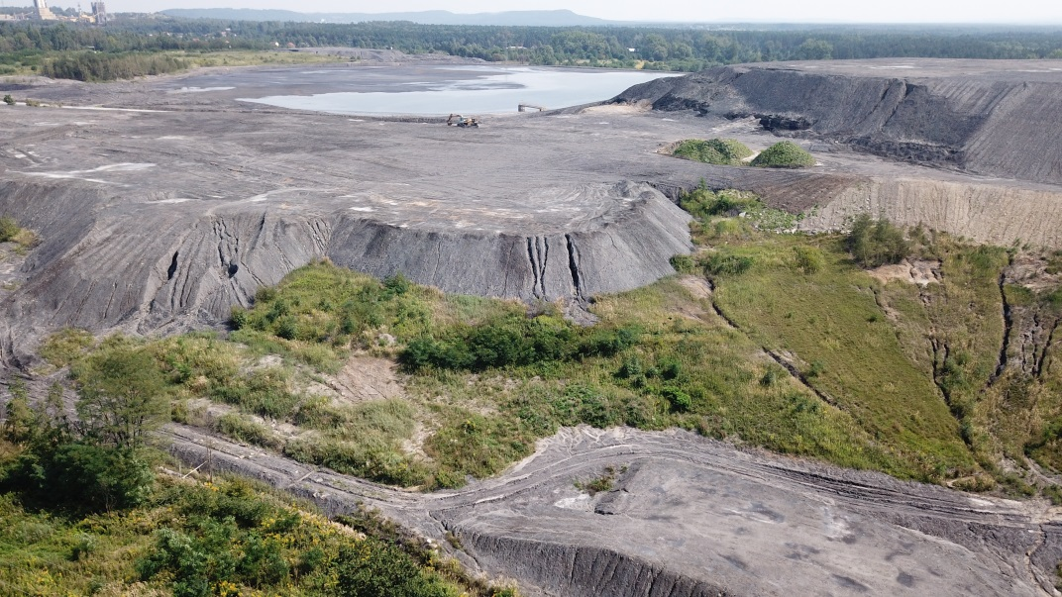
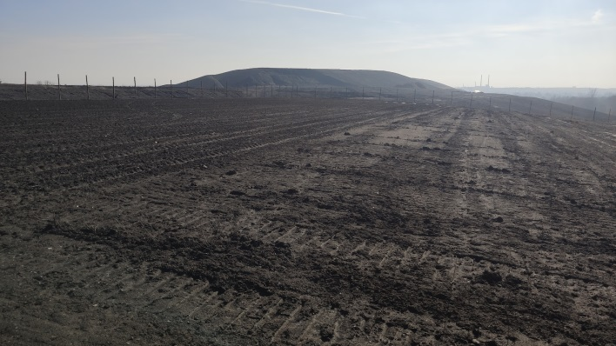
Janina Mine waste heap
The Janina Mine is an active coal mine in the south of Poland in Libiąż and property of Tauron Wydobycie S.A. It covers an area of about 80 hectares and reaches 35 m in height. It is one of the biggest mining spoil heaps of this kind located in the Silesia region in Poland.

Slide 8
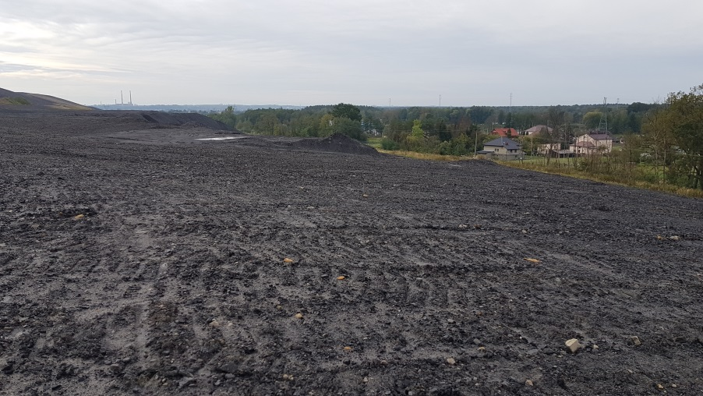
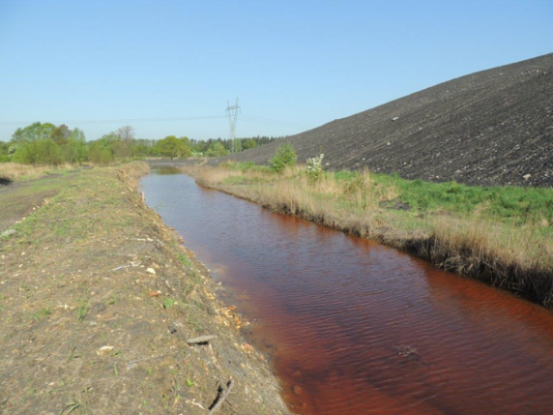
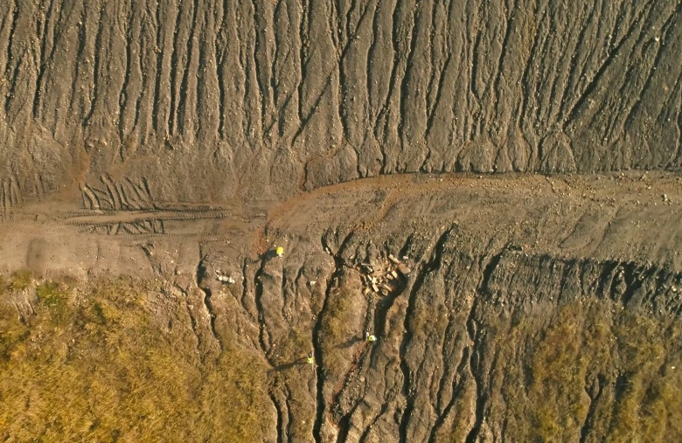
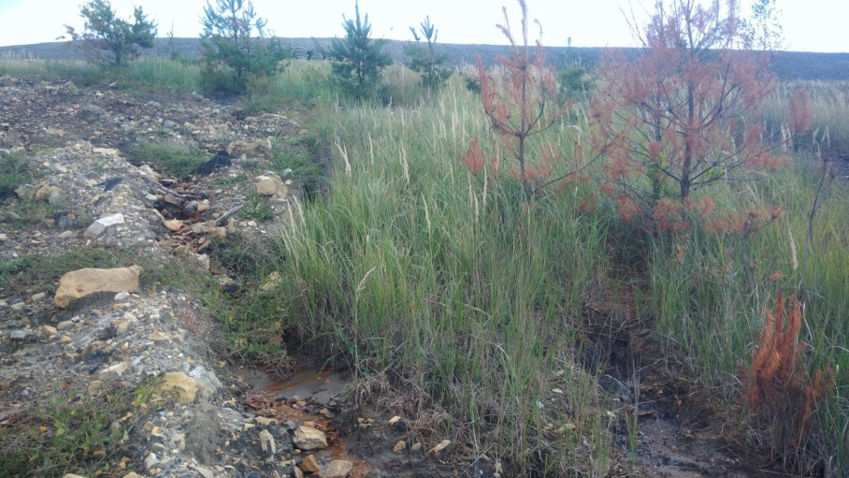
ENVIROMENTAL Problems of Janina Heap
Acid rock drainage from waste dumps contributes to deterioration of the condition of surface water.
Water erosion and waste mass displacements occur on the slopes of the waste heap, which generates costs associated with securing and reinforcing the waste heap.
Wind erosion contributes to the negative impact which waste dumps have on the adjacent areas (including areas of single-family housing)
Negative impact on the aesthetic value of the landscape
residential area
Negative impact on of the landscape
damaged plants
Acid rock drainage
pH<3
Strong water and wind erosion
No possibility of greening the area

Slide 9
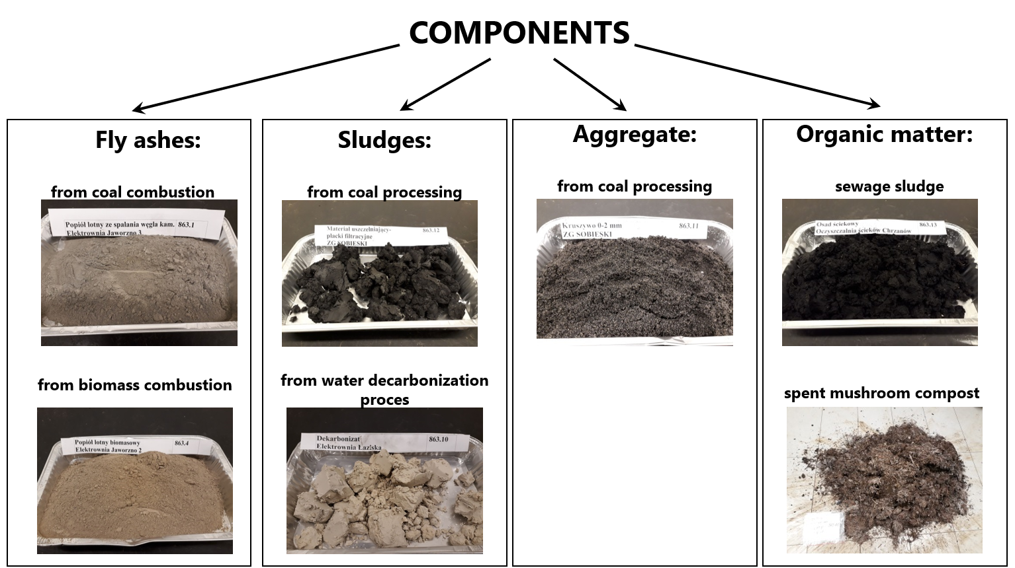
Artificial soil substitutes in GIG LABORATORY
Industrial by-products from Power Plants, mining waste from Coal Mine and organic waste were used as components for elaborating soil substitutes blends.
MINERAL WASTE
Fly ash from coal combustion
Fly ash from plant biomass combustion
Decarbonisation lime from water softening process
Aggregate (0-2 mm) from mine waste processing
Sealing material from coal processing
Energetic slag from coal combustion
ORGANIC WASTE
Sewage sludge
Spent mushroom compost
Laboratory analysis of components:
Elements i.e.: N, P, K, Mg, Na, Ca, Fe, Al, Si, S, Cl
Heavy metals i.e.: As, Ba, Cd, Co, Cr, Cu, Mn, Mo, Ni, Pb, Se, Zn (…)
organic matter,
dry matter,
Electrical conductivity,
pH

Slide 10
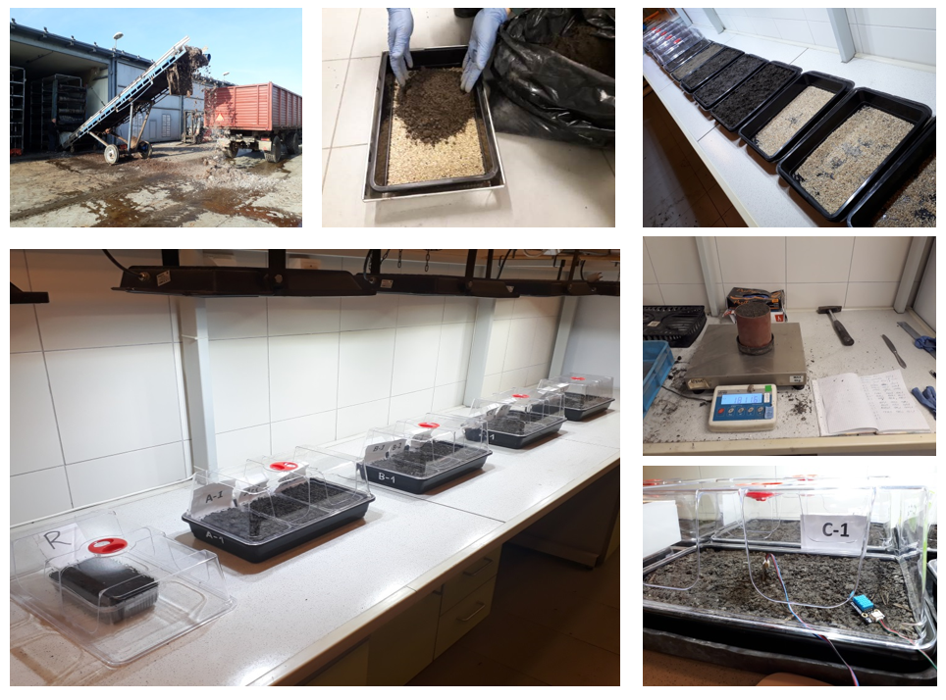
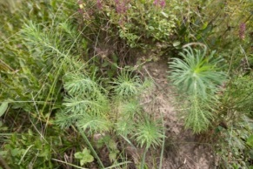
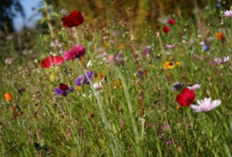
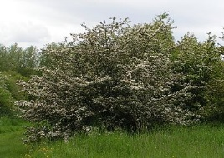
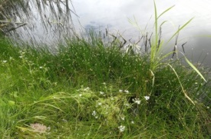
Artificial soil substitutes
Different shares of components allowed preparing soils substitutes suitable for different habitats (A-D):
Four types of artificial solis (A-D) were for different habitats:
A-Soils for low vegetation of dry and poor habitats (A1-A3)
B- Soils for low vegetation of fresh habitats (B1-B3)
C-Soils for woody and shrub-like vegetation (C1-C3)
D-Soils for vegetation of wet and humid habitats (D1-D3)
A
B
C
D

Slide 11
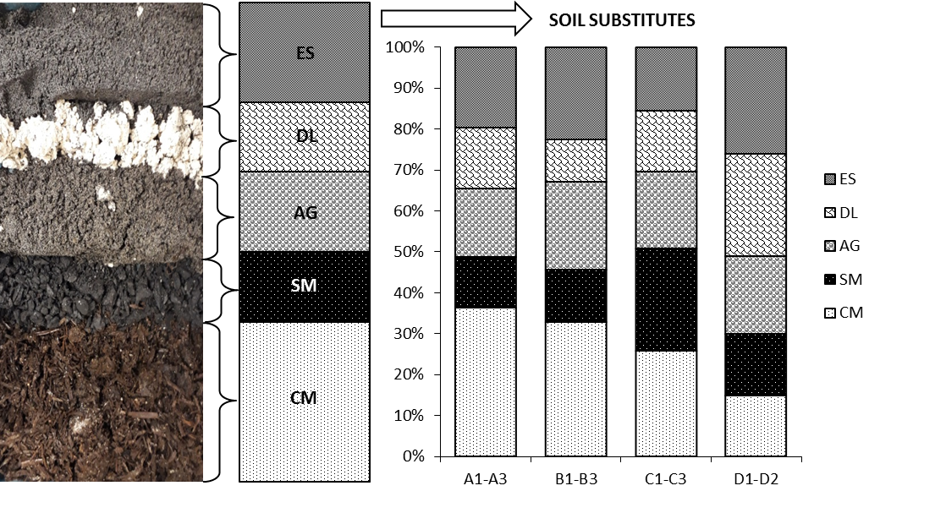
Results of germination of SINAPIS ALBA L.
Fly ash from coal combustion
Fly ash from plant biomass combustion
Decarbonisation lime from water softening process
Aggregate (0-2 mm) from mine waste processing
Sealing material from coal processing
Sewage sludge
Spent mushroom compost
Decarbonisation lime from water softening process (DL)
Aggregate (0-2 mm) from mine waste processing (AG)
Sealing material from coal processing (SM)
Energetic slag from coal combustion (ES)
Spent mushroom compost (CM)
The best germination result was obtained for soil based on the content of energy sludge instead of fly ash from coal or biomass combustion

Slide 12
TESTING GROuND
The surface (4000m²) was geodetically divided into four sections. In the sections with meadow vegetation, six experimental plots were set (12 plots in total).
10m
10 m
10 m
10 m
Experimental
plot (1 m²)
80m
A-dry meadow habitats
B-mesic meadow habitats
C-shrubs
D-wetland habitats
Detailed lists of vascular plant species in the experimental plots were made in June 2021 and June 2022.
D
C
B
A

Slide 13
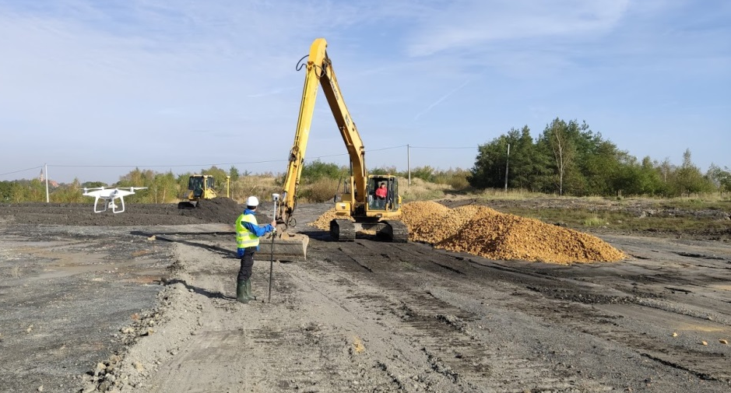
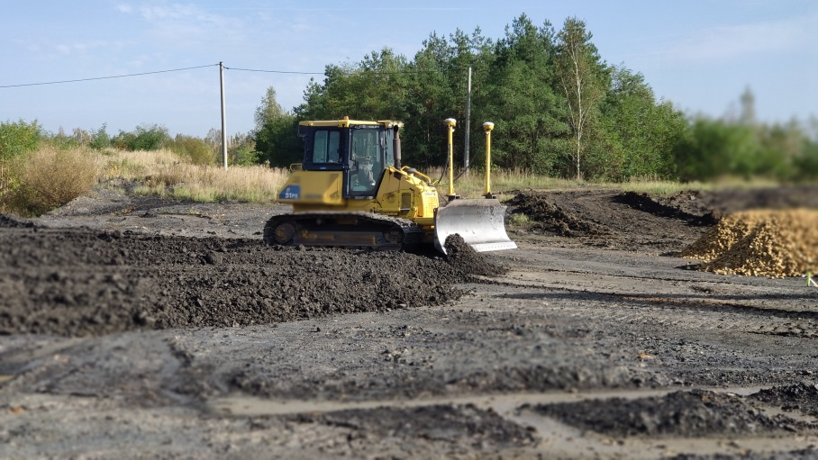
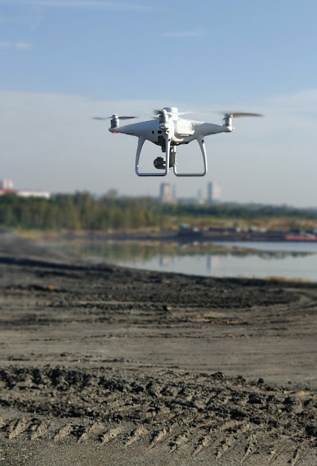
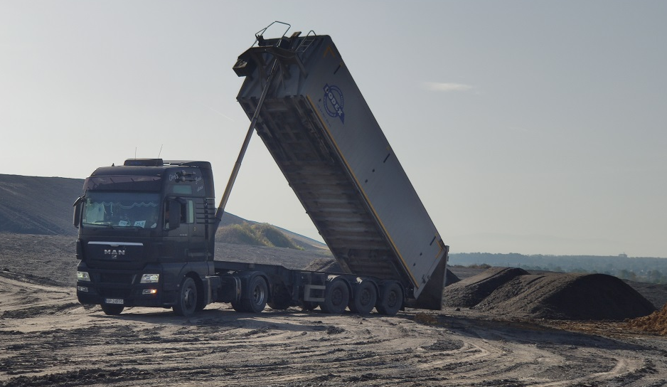
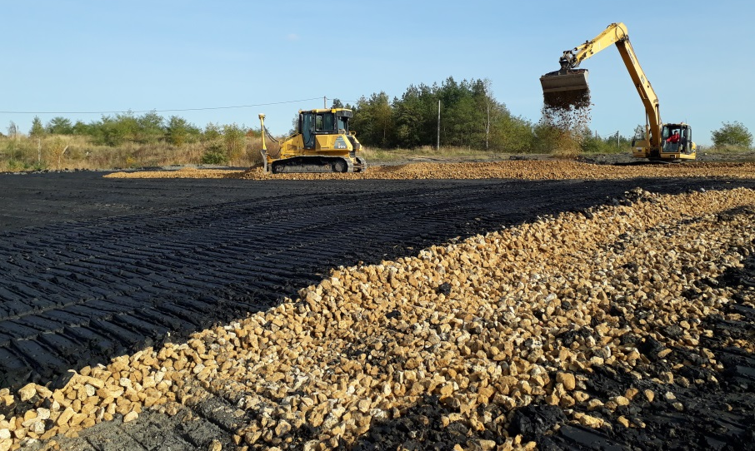
Field works on the Janina waste heap
October 2020

Slide 14
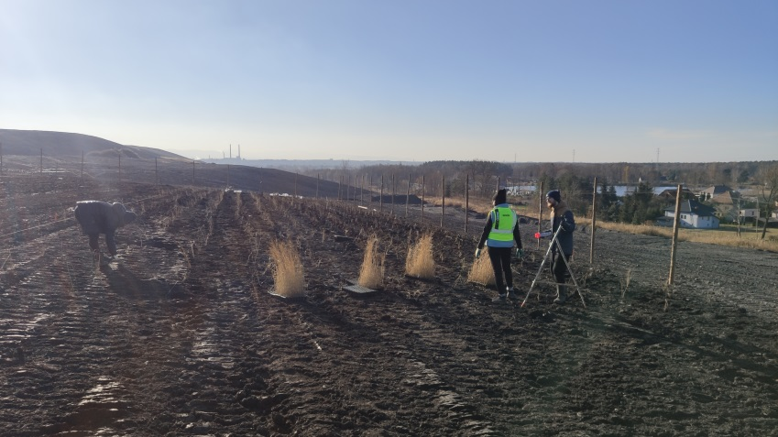
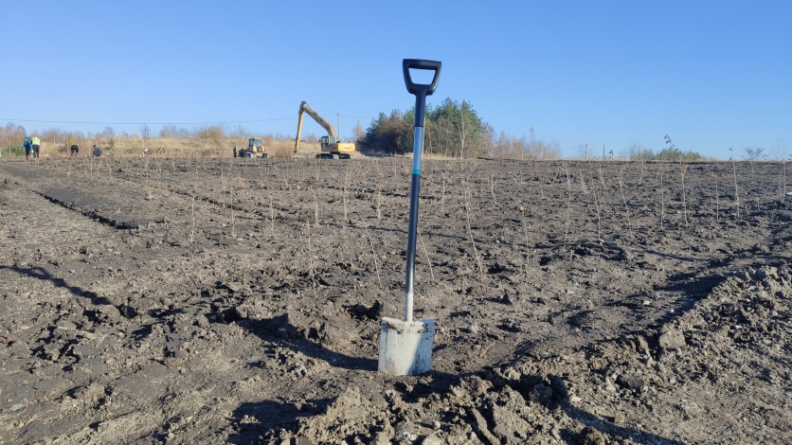
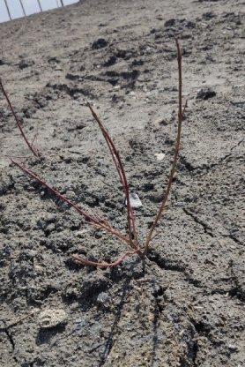
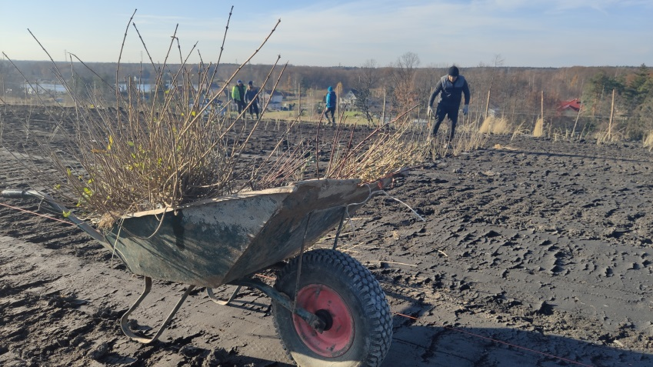
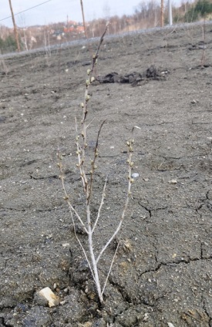
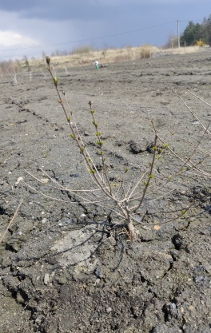
Planting the Janina waste heap for reclamation
The first planting of shrubs (approx. 1000 seedlings) and sowing the seeds of the flower meadow was started in November 2020

Slide 15
RESULT of the test with meadow species
The proportion of each vegetation communities identified in the first and second year on dry and mesic habitats
The highest average cover of the species was observed for mesic habitat vegetation: 120% for soil A3 and 96% for soil B2.
The average coverage of species typical of dry habitat vegetation was comparable on soil A3 and B2.
The species characteristics for ruderal vegetation can spread mainly by wind and fast-cover open areas
The other species of vegetation were below 3%
Soil A3

Slide 16
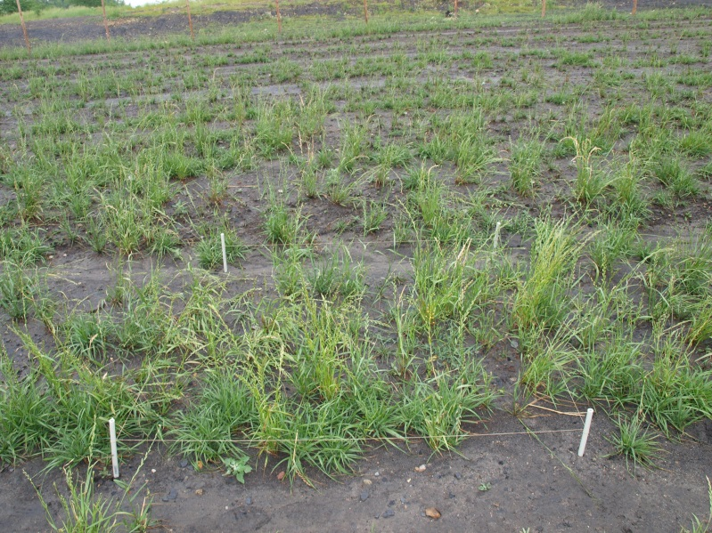
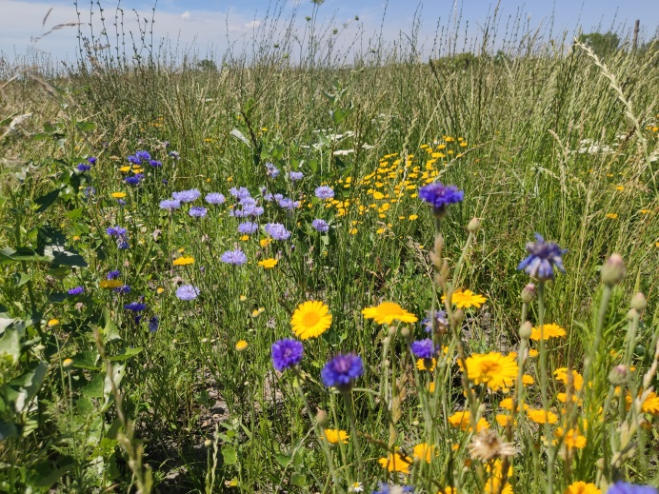
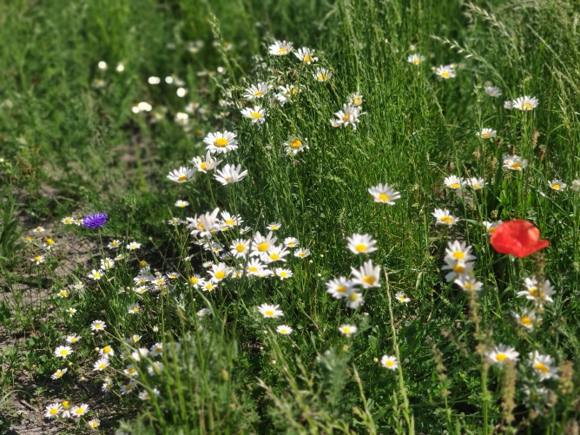
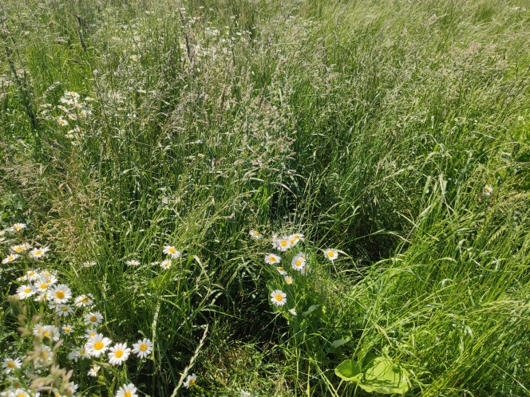
RESULT of the test with meadow species
Examples of the experimental plots in the testing ground
2021
Development of meadow vegetation using soil substitutes at Janina Mine waste heap in June 2022
2022
dry meadow vegetation
mesic meadow vegetation

Slide 17
Physicochemical characteristics of soil substitutes during vegetation
Soil substitute for mesic meadow
Soil substitute for dry meadow
EC - electrical conductivity (mS·cm⁻¹)
OM-organic mater (%)
The data of physocochemical parameters gathered throughout phytotests with mesic and dry meadow showed a promising opportunity for implementing the tested soil substitutes as trials at the coal mine affected areas.

Slide 18
Physicochemical characteristics of soil substitutes during vegetation
In the second year of the experiment, the heavy metals content of the soil covers was also investigated
The concentrations of toxic heavy metals in soil covers did not exceed the permissible thresholds for soils classified in Group III, i.e., wooded and shrub lands as well as green areas (Minister of Environmental Protection, 2016)
The result of soil substitute for dry meadow habitats was comparable
The result od soil substitute for mesic meadow habitats

Slide 19
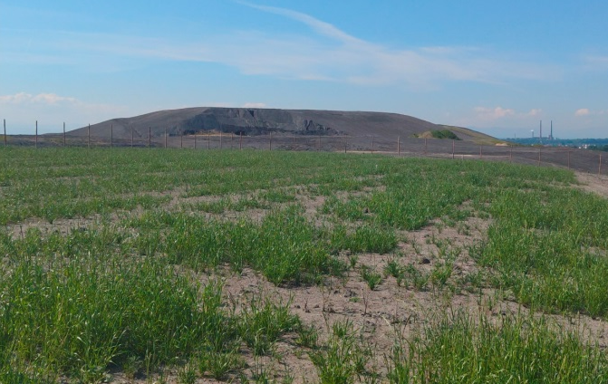
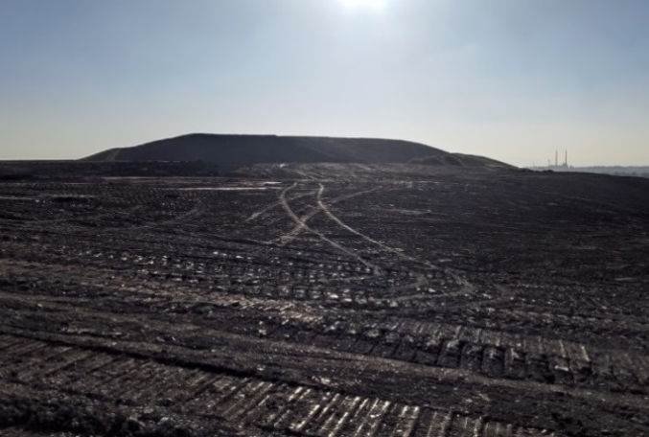
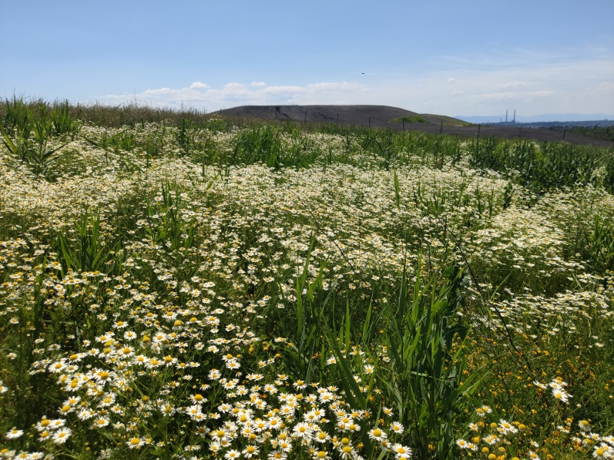
A testing ground of Janina Waste heap before and after reclamation
2020
2021
2022
The results of the application of the soil substitutes on the testing ground showed spontaneous successions of meadow species after the second year of growing season.
Testing ground in 2022 after planting and seeding

Slide 20
Project website: www.recoveryproject.eu

Slide 21
Video (UPDATE)
https://www.youtube.com/watch?v=ZfOP0soqpms

Slide 22
Thank you for your attention!
Grant Agreement No. 847205-RECOVERY-RFCS-2018 07/2019 - 06/2023
Alicja Krzemień

